Slide 1
DETAILS
MAKE YOUR LAYOUT COME ALIVE
BY
BRIAN W. SHERON, MMR update 5/1/2023

Slide 2
"The world is full of obvious things which nobody by any chance ever observes."
Sherlock Holmes Quote
-The Hound of the Baskervilles
Chapter 3: "The Problem"
“You see, but you do not observe. The distinction is clear.”
Sherlock Holmes Quote
-A Scandal in Bohemia

Slide 3
It's the little details that are vital. Little things make big things happen.
John Wooden
Success is the sum of details.
Harvey S. Firestone
Details create the big picture.
Sanford I. Weill
A still image attracts the viewer with an overall impact, then reveals smaller details upon further study.
Thomas Kinkade
Art is all in the details.
Christian Marclay

Slide 4
FOR MANY MODEL RAILROADERS, THE OBJECTIVE IS TO CREATE REALISTIC AND INTERESTING SCENES WITH A RAILROAD THEME
IN MANY RESPECTS, MODEL RAILROADERS ARE ARTISTS WORKING IN 3 DIMENSIONS
SO WHAT MAKES A REALISTIC SCENE?
IS IT PROTOTYPIC AND BELIEVABLE?
AND WHAT MAKES A INTERESTING SCENE?
IS THE VIEWER’S EYE DRAWN TO THE SCENE?
ONCE THE VIEWER IS DRAWN TO THE SCENE, DO THEY REMAIN FOCUSED ON IT AND TAKE IN THE DETAIL? (DO THEY “OBSERVE” THE SCENE, ARE THEY INTERESTED IN IT)?

Slide 5
THE MAIN OBJECTIVE OF THIS CLINIC IS NOT TO SHOW
YOU HOW TO ADD DETAILS TO A SCENE, BUT TO SHOW YOU WHAT DETAILS CAN ADD TO A SCENE
SO LET’S TAKE A LOOK AT SOME REAL LIFE DETAILS

Slide 6
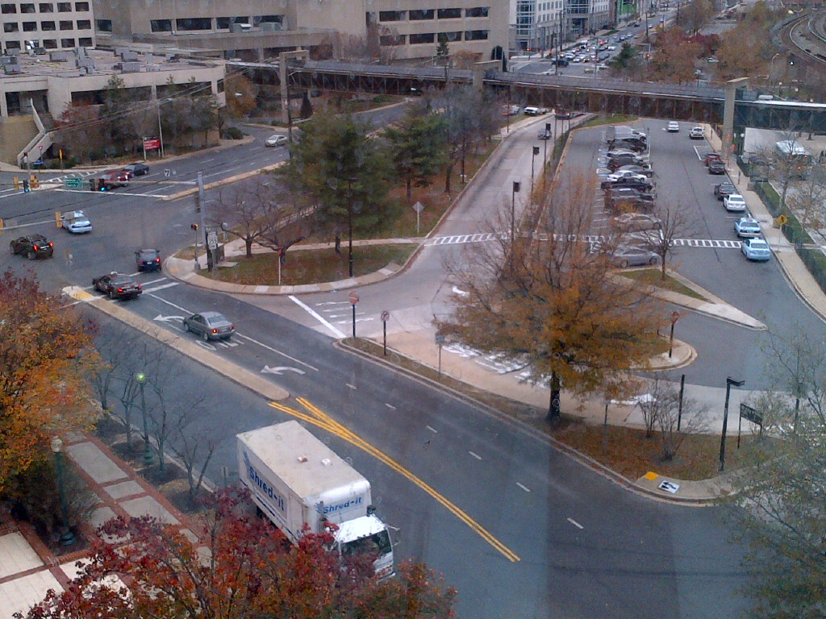
ROCKVILLE, MD METRO ENTRANCE
HOW MANY DIFFERENT COLOR PAVEMENTS DO YOU SEE? AT LEAST 5
HOW MANY DIFFERENT COLOR SIDEWALKS DO YOU SEE? AT LEAST 3
HOW MANY SIGNS DO YOU SEE? AT LEAST 16

Slide 7
OTHER DETAILS:
LOTS OF STREET MARKINGS
ROOF DETAIL ON BUILDING AT UPPER LEFT
VARIETY OF TREES AND STREET LIGHTS

Slide 8
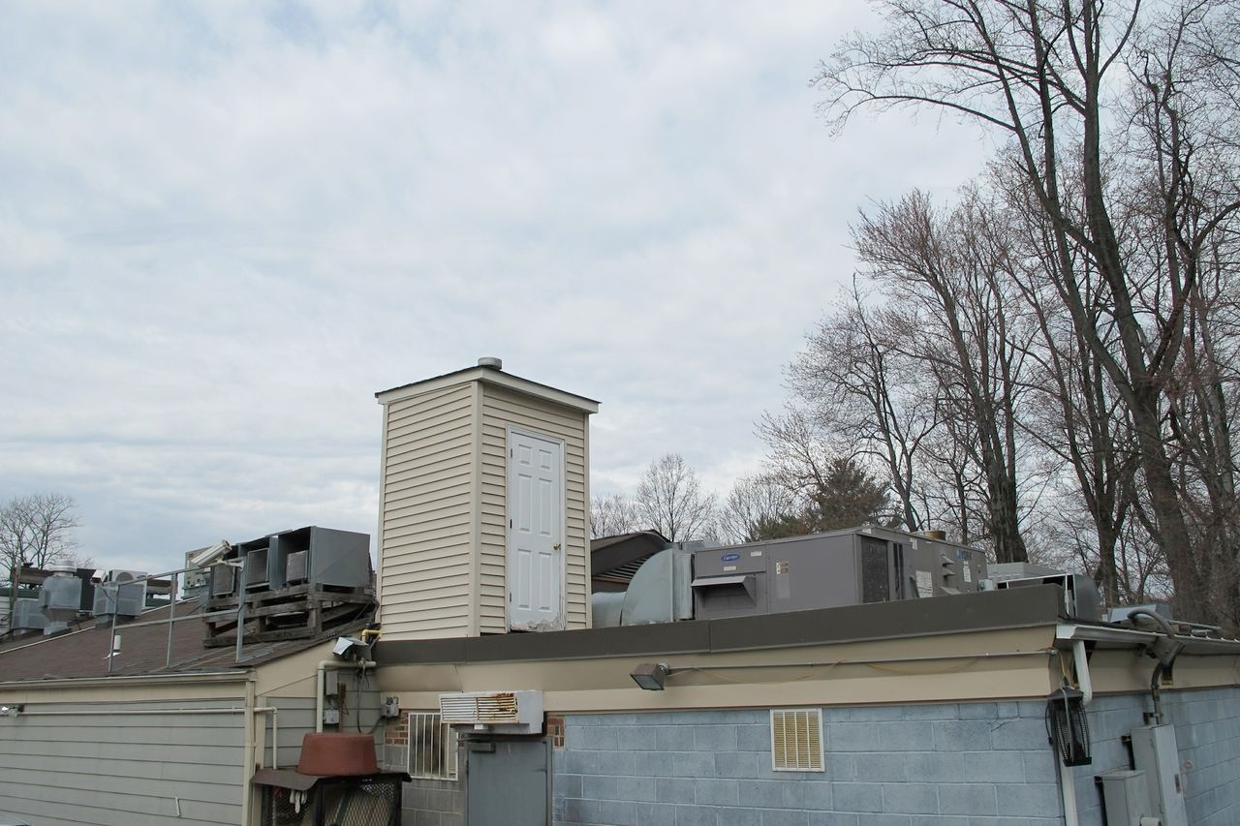
SOME ROOF DETAILS ON A LOCAL CHINESE RESTAURANT

Slide 9
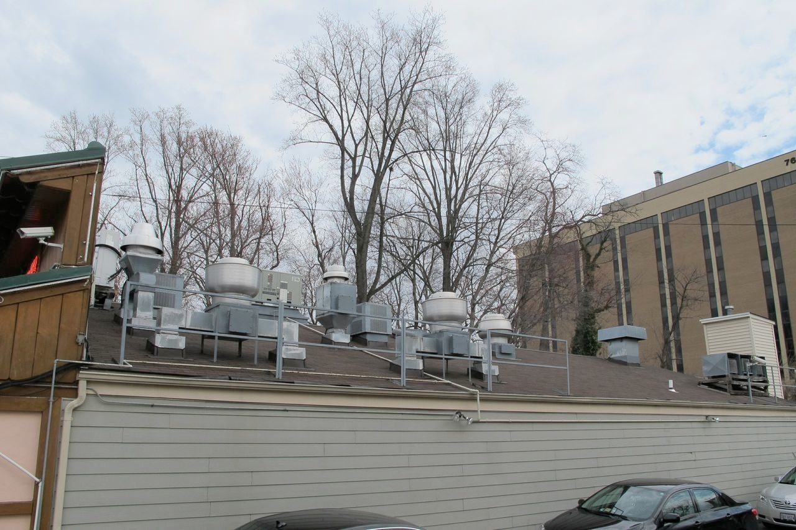
MORE ROOF DETAILS ON A LOCAL CHINESE RESTAURANT

Slide 10
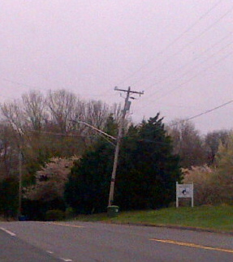
THINGS IN REAL LIFE AREN’T
ALWAYS STRAIGHT!

Slide 11
TRY TO BREAK UP YOUR SCENERY INTO INDIVIDUAL SCENES
INDIVIDUAL SCENES FOCUS AND CAPTURE THE VIEWER’S ATTENTION
YOU CAN CREATE AN INDIVIDUAL SCENE BY PROVIDING SOMETHING
“GOING ON,” SOME ACTION TAKING PLACE
AS PEOPLE FOCUS ON LEARNING ABOUT WHAT IS GOING ON IN THE SCENE, THEY THEN NOTICE AND TAKE IN THE DETAIL. THIS WILL TEND TO HOLD THEIR ATTENTION
IN THIS CLINIC, MY OBJECTIVE IS TO SHOW YOU EXAMPLES OF HOW DETAILS
CAN ENHANCE SCENES
I’M USING PRIMARILY PHOTOS FROM MY LAYOUT AND FROM BERNIE
HALLORAN’S OUTSTANDING LAYOUT
THE DETAILS I’M SHOWING AND DISCUSSING ARE BY NO MEANS A
COMPLETE LIST. RATHER, THEY ARE REPRESENTATIVE EXAMPLES
OF THE KINDS OF DETAILS THAT SHOULD BE CONSIDERED

Slide 12
SO LET’S TAKE A LOOK AT SOME DETAILS
I’VE TRIED TO IDENTIFY WHAT I THINK ARE MAJOR CATEGORIES FOR DETAILS:
PEOPLE
STREET DETAILS
BUILDING DETAILS
BUILDING SIDE DETAILS
BUILDING ROOF DETAILS
TRACK DETAILS
SIGNS
WEATHERING
BACKGROUND AND PERSPECTIVE

Slide 13
PEOPLE
UNLESS YOU ARE MODELING A DESERTED AREA. THERE ARE USUALLY PEOPLE AROUND.
CITY, TOWN, OR VILLAGE STREETS USUALLY HAVE PEOPLE WALKING AROUND AND DOING THINGS.
THINK ABOUT WHAT PEOPLE DO IN REAL LIFE.

Slide 14
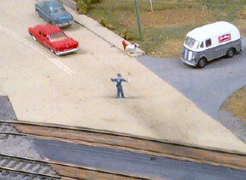
TRAFFIC COP DIRECTING TRAFFIC
AND A DOG AND FIRE HYDRANT
ON JIM BREWER’S LAYOUT

Slide 15
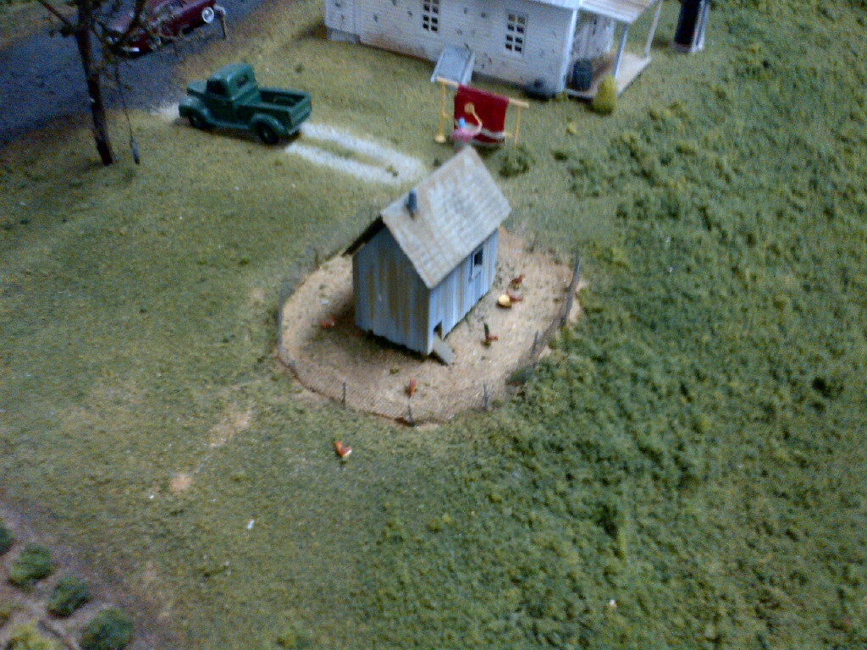
HOMEOWNER BEATING A RUG
ON JIM BREWER’S LAYOUT

Slide 16
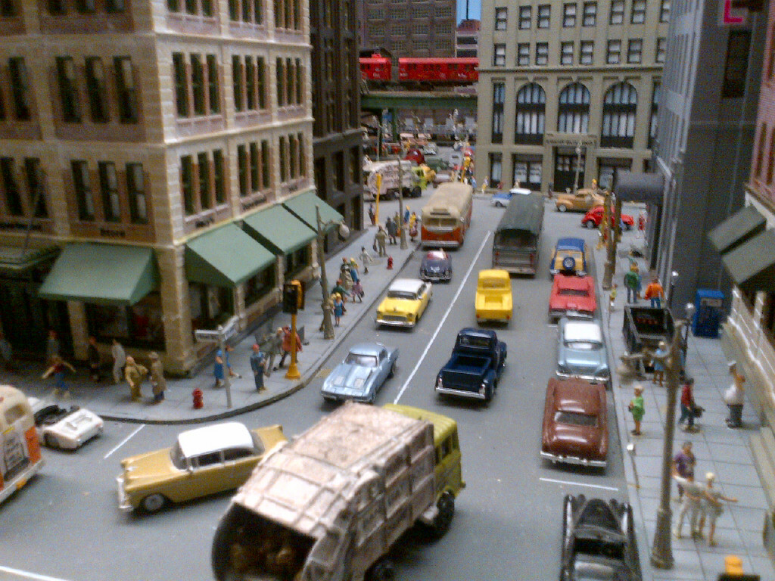
A BUSY NEW YORK CITY SCENE

Slide 17
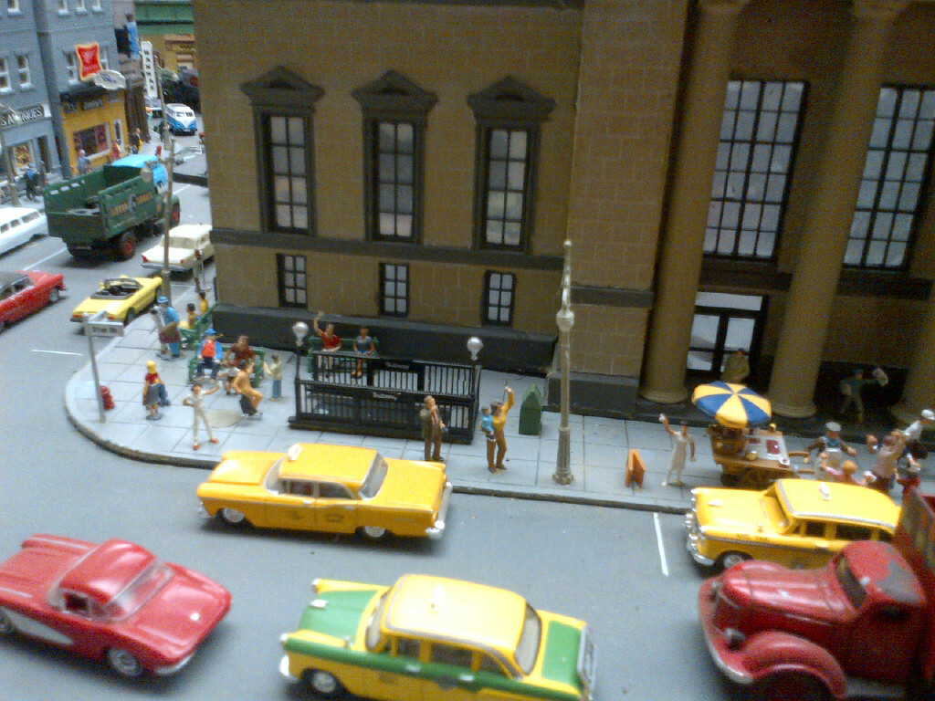
ANOTHER BUSY NEW YORK CITY SCENE

Slide 18
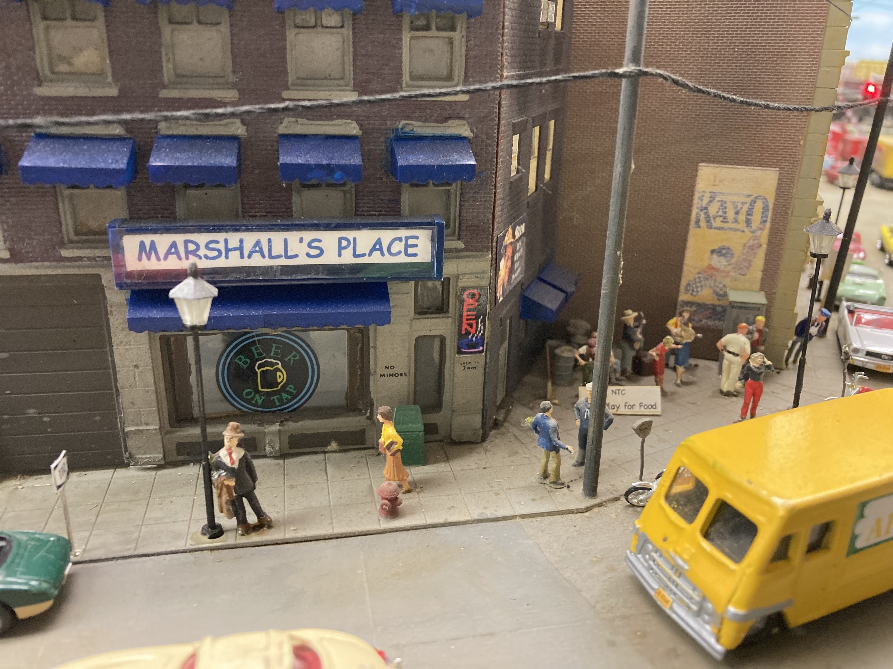
ONE TOO MANY AT MARSHALL’S PLACE

Slide 19
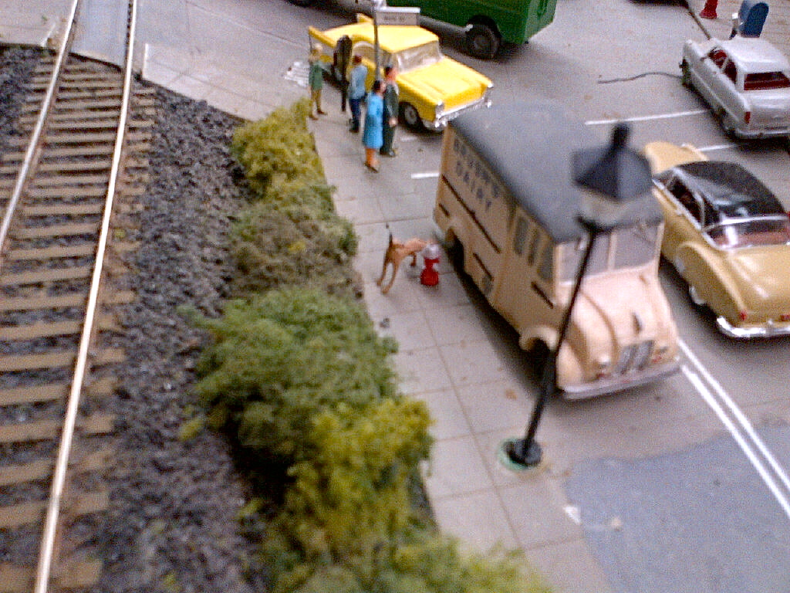
A DOG’S GOTTA DO WHAT A DOG’S GOTTA DO!

Slide 20
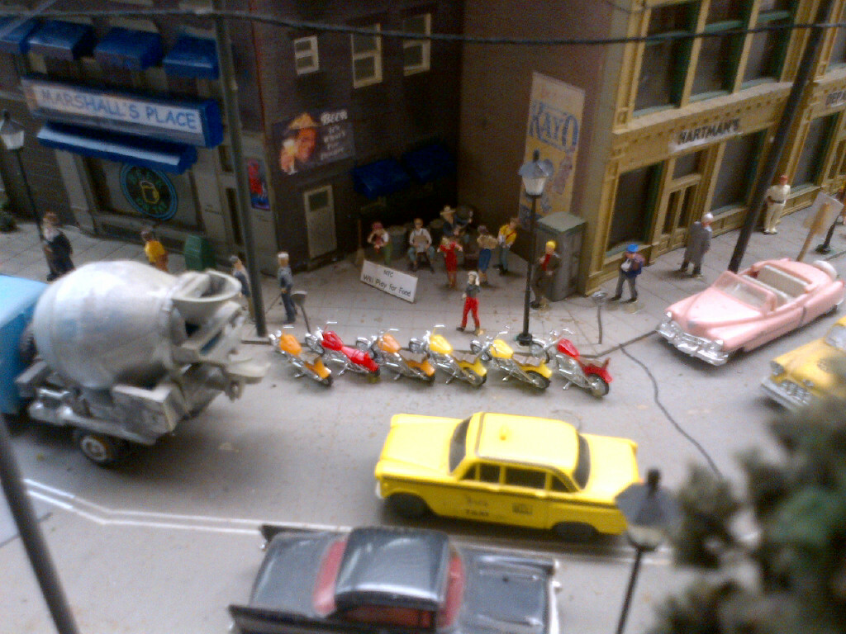
A DOWN-AND-OUT STREET BAND PLAYING FOR MONEY
IN FRONT OF WHAT IS OBVIOUSLY A BIKER BAR

Slide 21
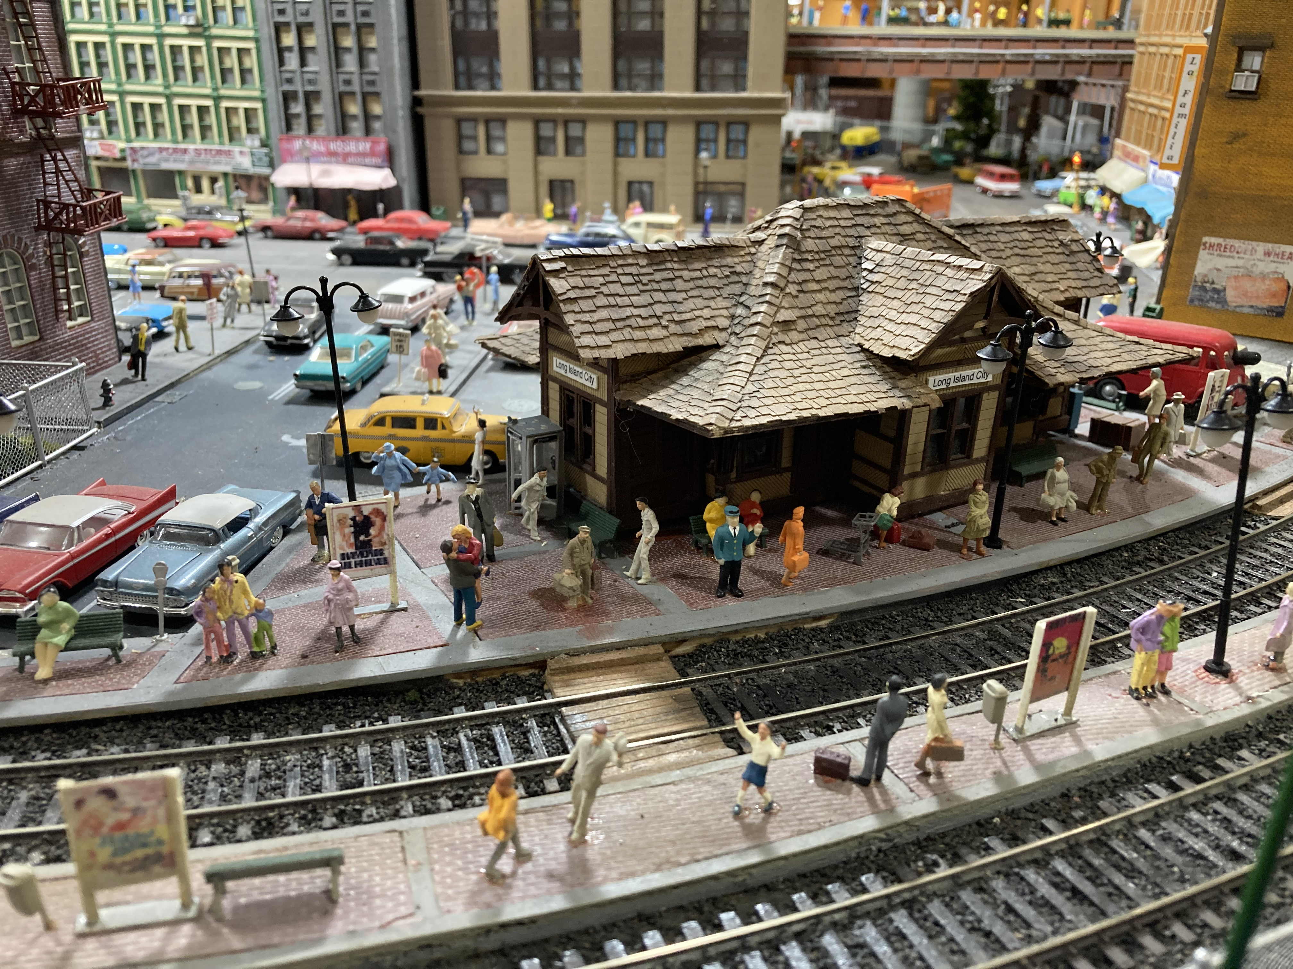
A BUSY TRAIN STATION SCENE

Slide 22
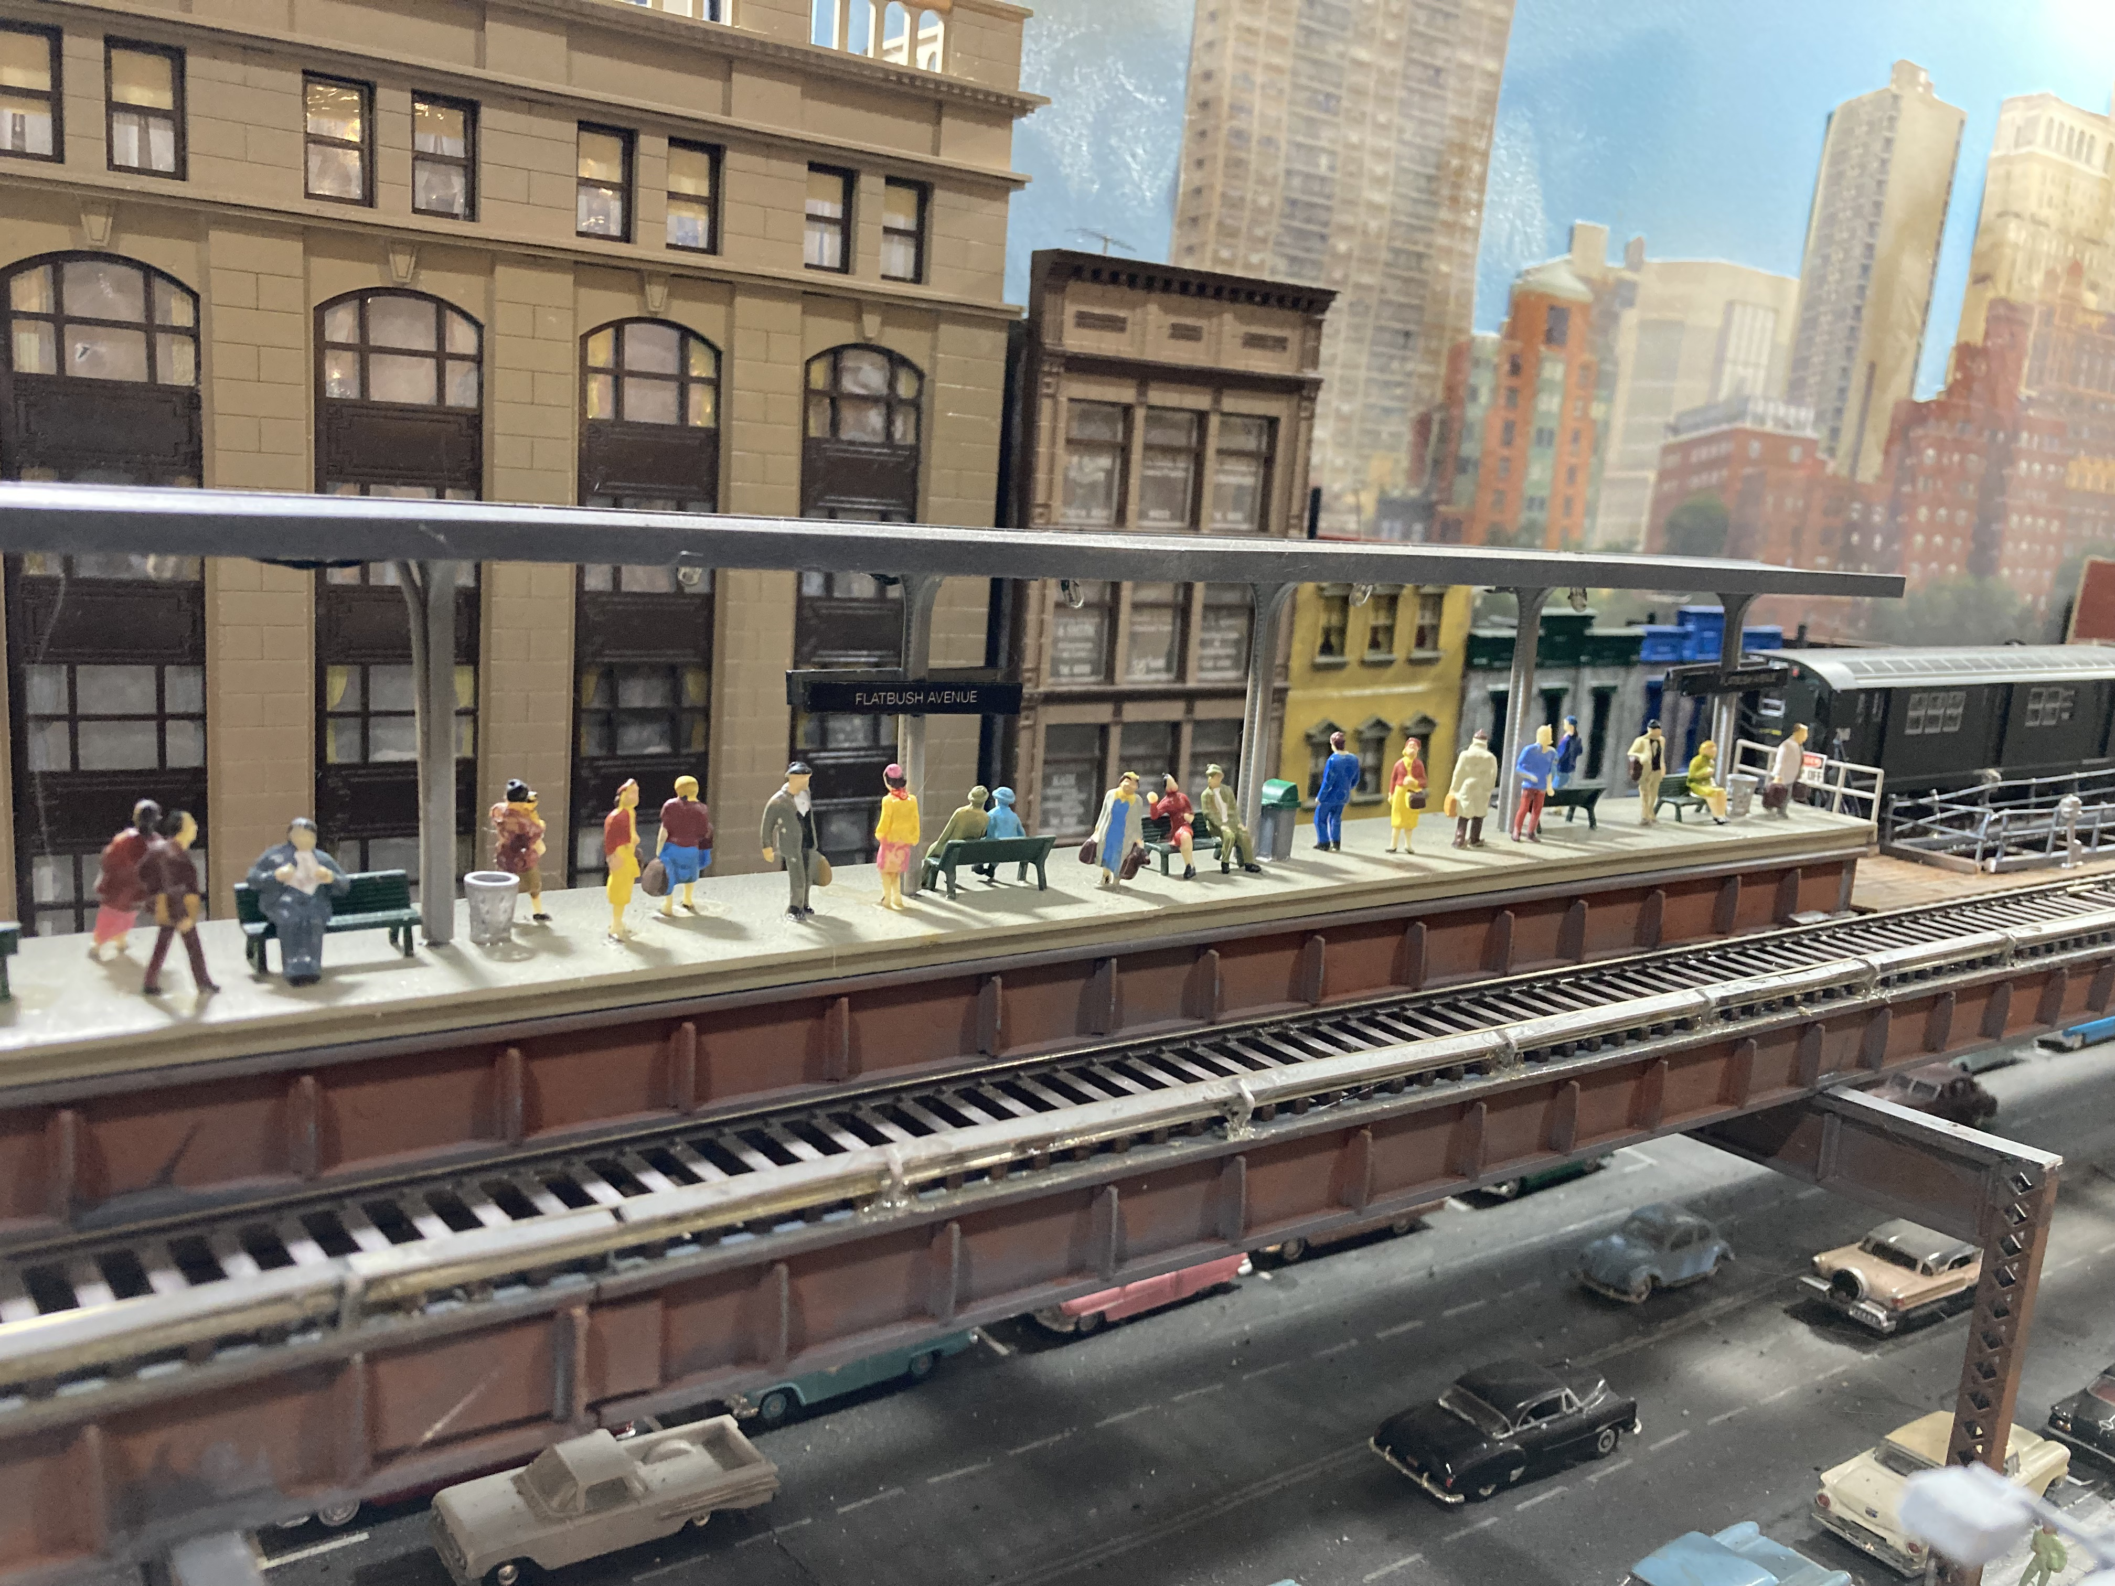
A BUSY ELEVATED RAILROAD STATION PLATFORM

Slide 23
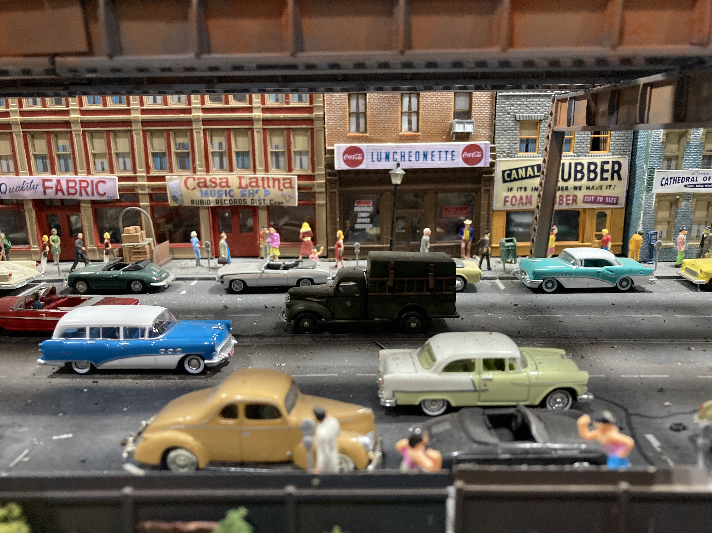
A BUSY STREET SCENE UNDER AN EL

Slide 24
STREET DETAILS
STREET DETAILS INCLUDE:
THE STREET
STUFF ON AND NEAR THE STREET
STREETS ARE NEVER ONE COLOR. WEATHER, OIL, EXHAUST, AND REPAIRS ALL RESULT IN STREETS THAT ARE A MULTITUDE OF COLORS AND PATTERNS
DON’T BE AFRAID TO WEATHER YOUR STREETS. DARKENING THE ROADWAY IN THE CENTER OF THE LANE IS PROTOTYPICAL OF THE OIL AND EXHAUST THAT WILL ACCUMULATE ON THE ROAD OVER TIME
SECTIONS OF ROAD ARE OFTEN DUG UP AND THEN REPAVED WITH A DIFFERENT COLOR ASPHALT OR CONCRETE. DON’T BE AFRAID TO USE DIFFERENT COLORS ON SECTIONS OF YOUR ROADS

Slide 25
CRACKS IN ROADS ARE TYPICALLY FILLED WITH A BEAD OF TAR. A BLACK, FELT-TIP PEN CAN BE USED TO EASILY DRAW THESE CRACKS ON THE ROAD
MANY URBAN AND EVEN SUBURBAN ROADS HAVE SEWERS AND UTILITIES RUNNING BELOW THEM. ADD MANHOLE COVERS FOR REALISM
MOST ROADS ARE SLIGHTLY ARCHED SO WATER DRAINS TO THE SIDES. IF YOU MODEL CURBS, ADD RAINWATER SEWER DRAINS WHERE THE ROAD MEETS THE CURB
ON MANY STREETS, UTILITY POLES PARALLEL THE STREET. UTILITY POLES HOLD A WEALTH OF DETAIL

Slide 26
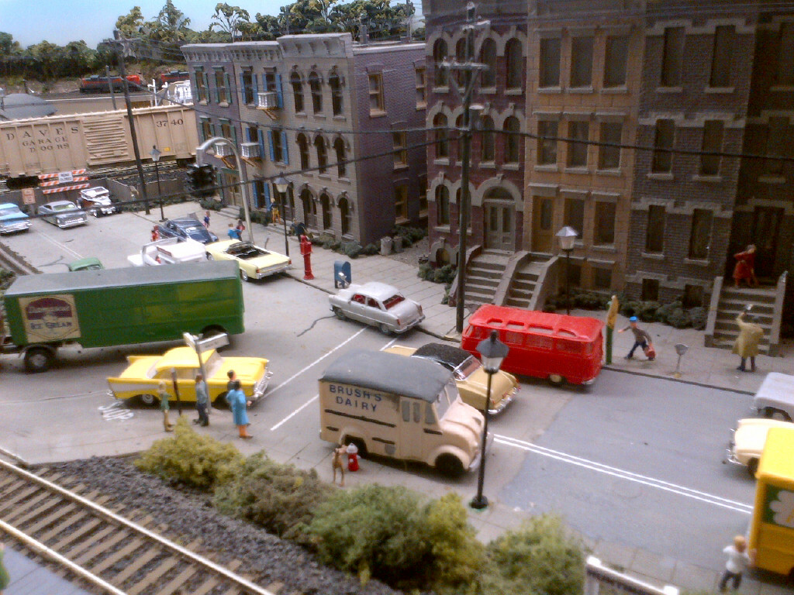
TODAY’S UTILITY POLES HOLD TRANSFORMERS, CAPACITOR BANKS,TELEPHONE CABLES, ETC.
MOST UTILITY POLES CARRY 3 PHASE ELECTRICITY (3 WIRES) AND MAYBE A GROUND WIRE (4TH WIRE). WIRES ARE NOT TAUT, BUT PURPOSELY HAVE A SPECIFIC “SAG” IN THEM
ADD TRANSFORMERS TO YOUR UTILITY POLES. USE DARK THREAD FOR THE WIRES. USE A HEAVIER THREAD, OR A YARN, FOR THE TELEPHONE CABLES.

Slide 27
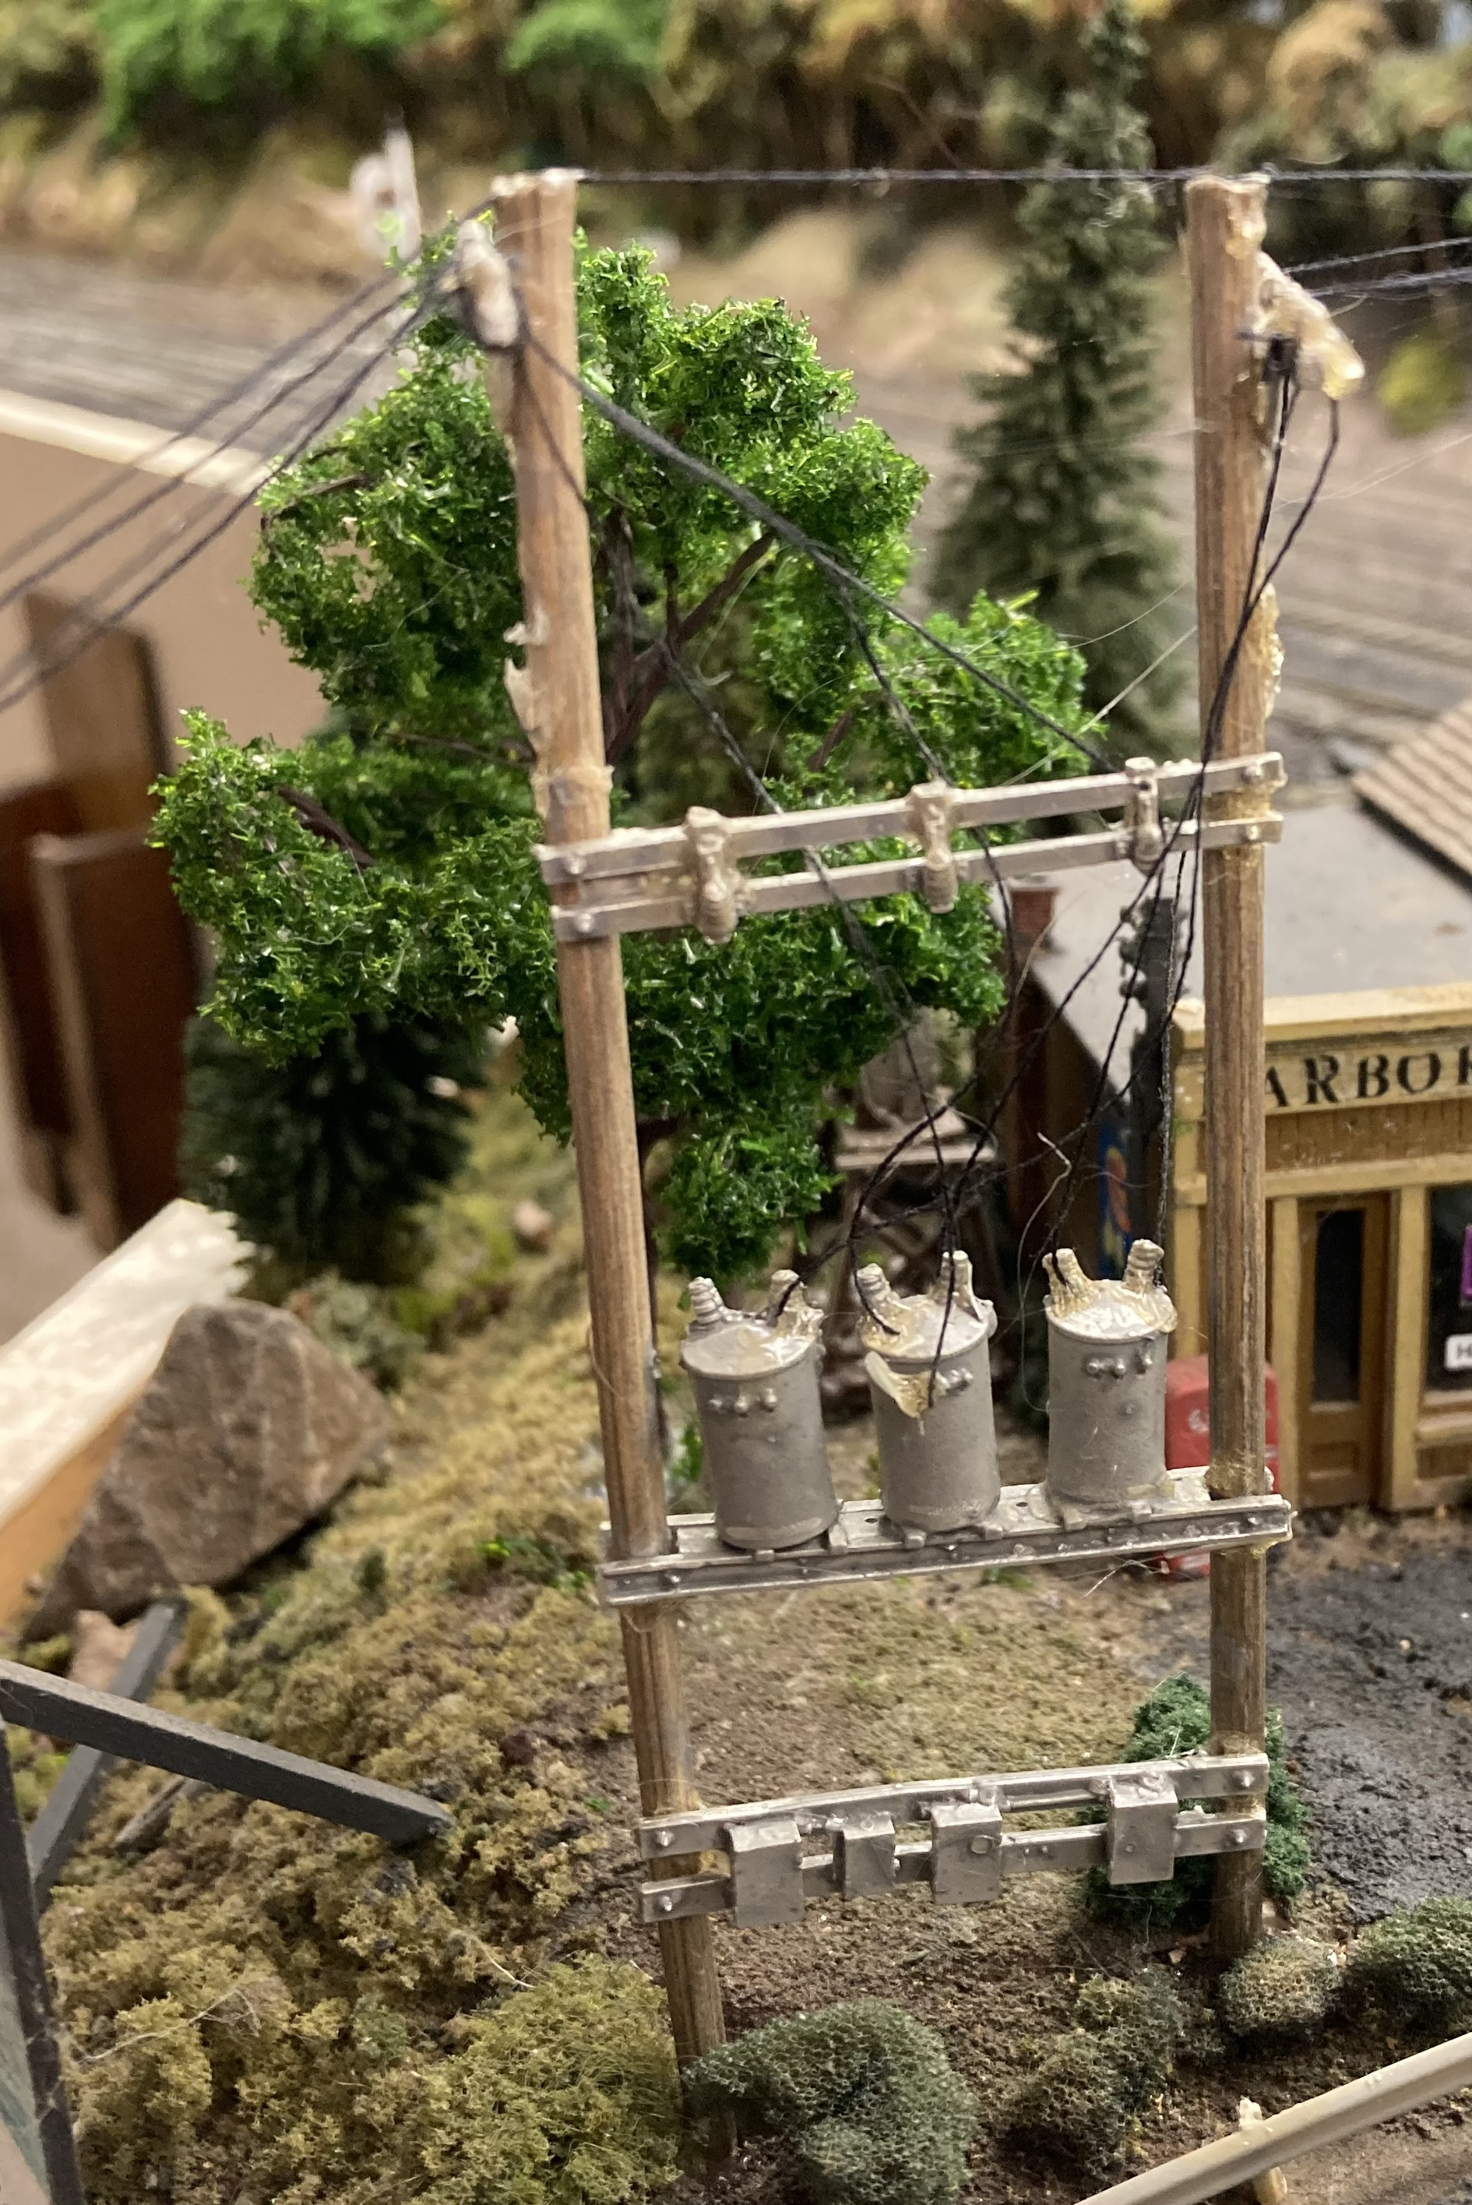
TRANSFORMER BANKS MAKE AN INTERESTING DETAIL

Slide 28
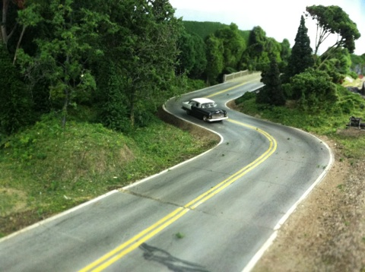
OUTSTANDING ROAD DETAIL AND WEATHERING
ON BERNIE HALLORAN’S LAYOUT

Slide 29
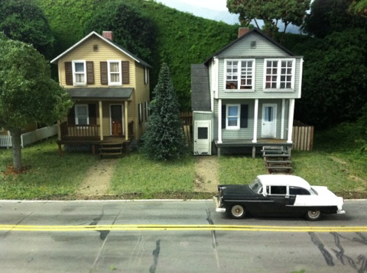
MORE ROAD DETAIL AND WEATHERING
ON BERNIE’S LAYOUT

Slide 30
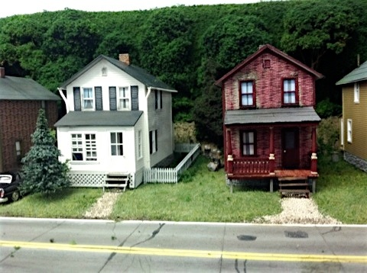
YET MORE...

Slide 31
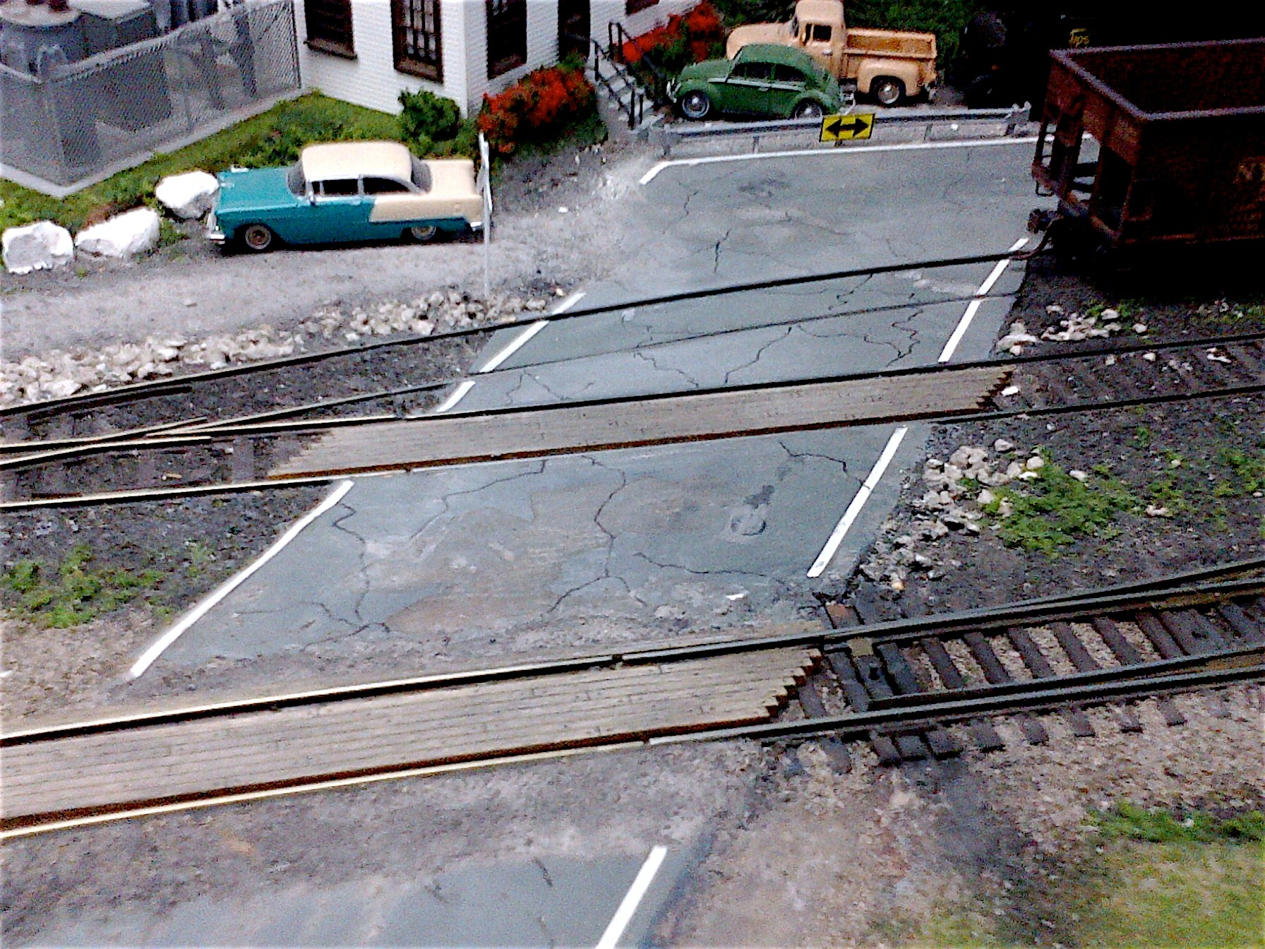
CROSSING DETAIL
ON BERNIE HALLORAN’S LAYOUT

Slide 32
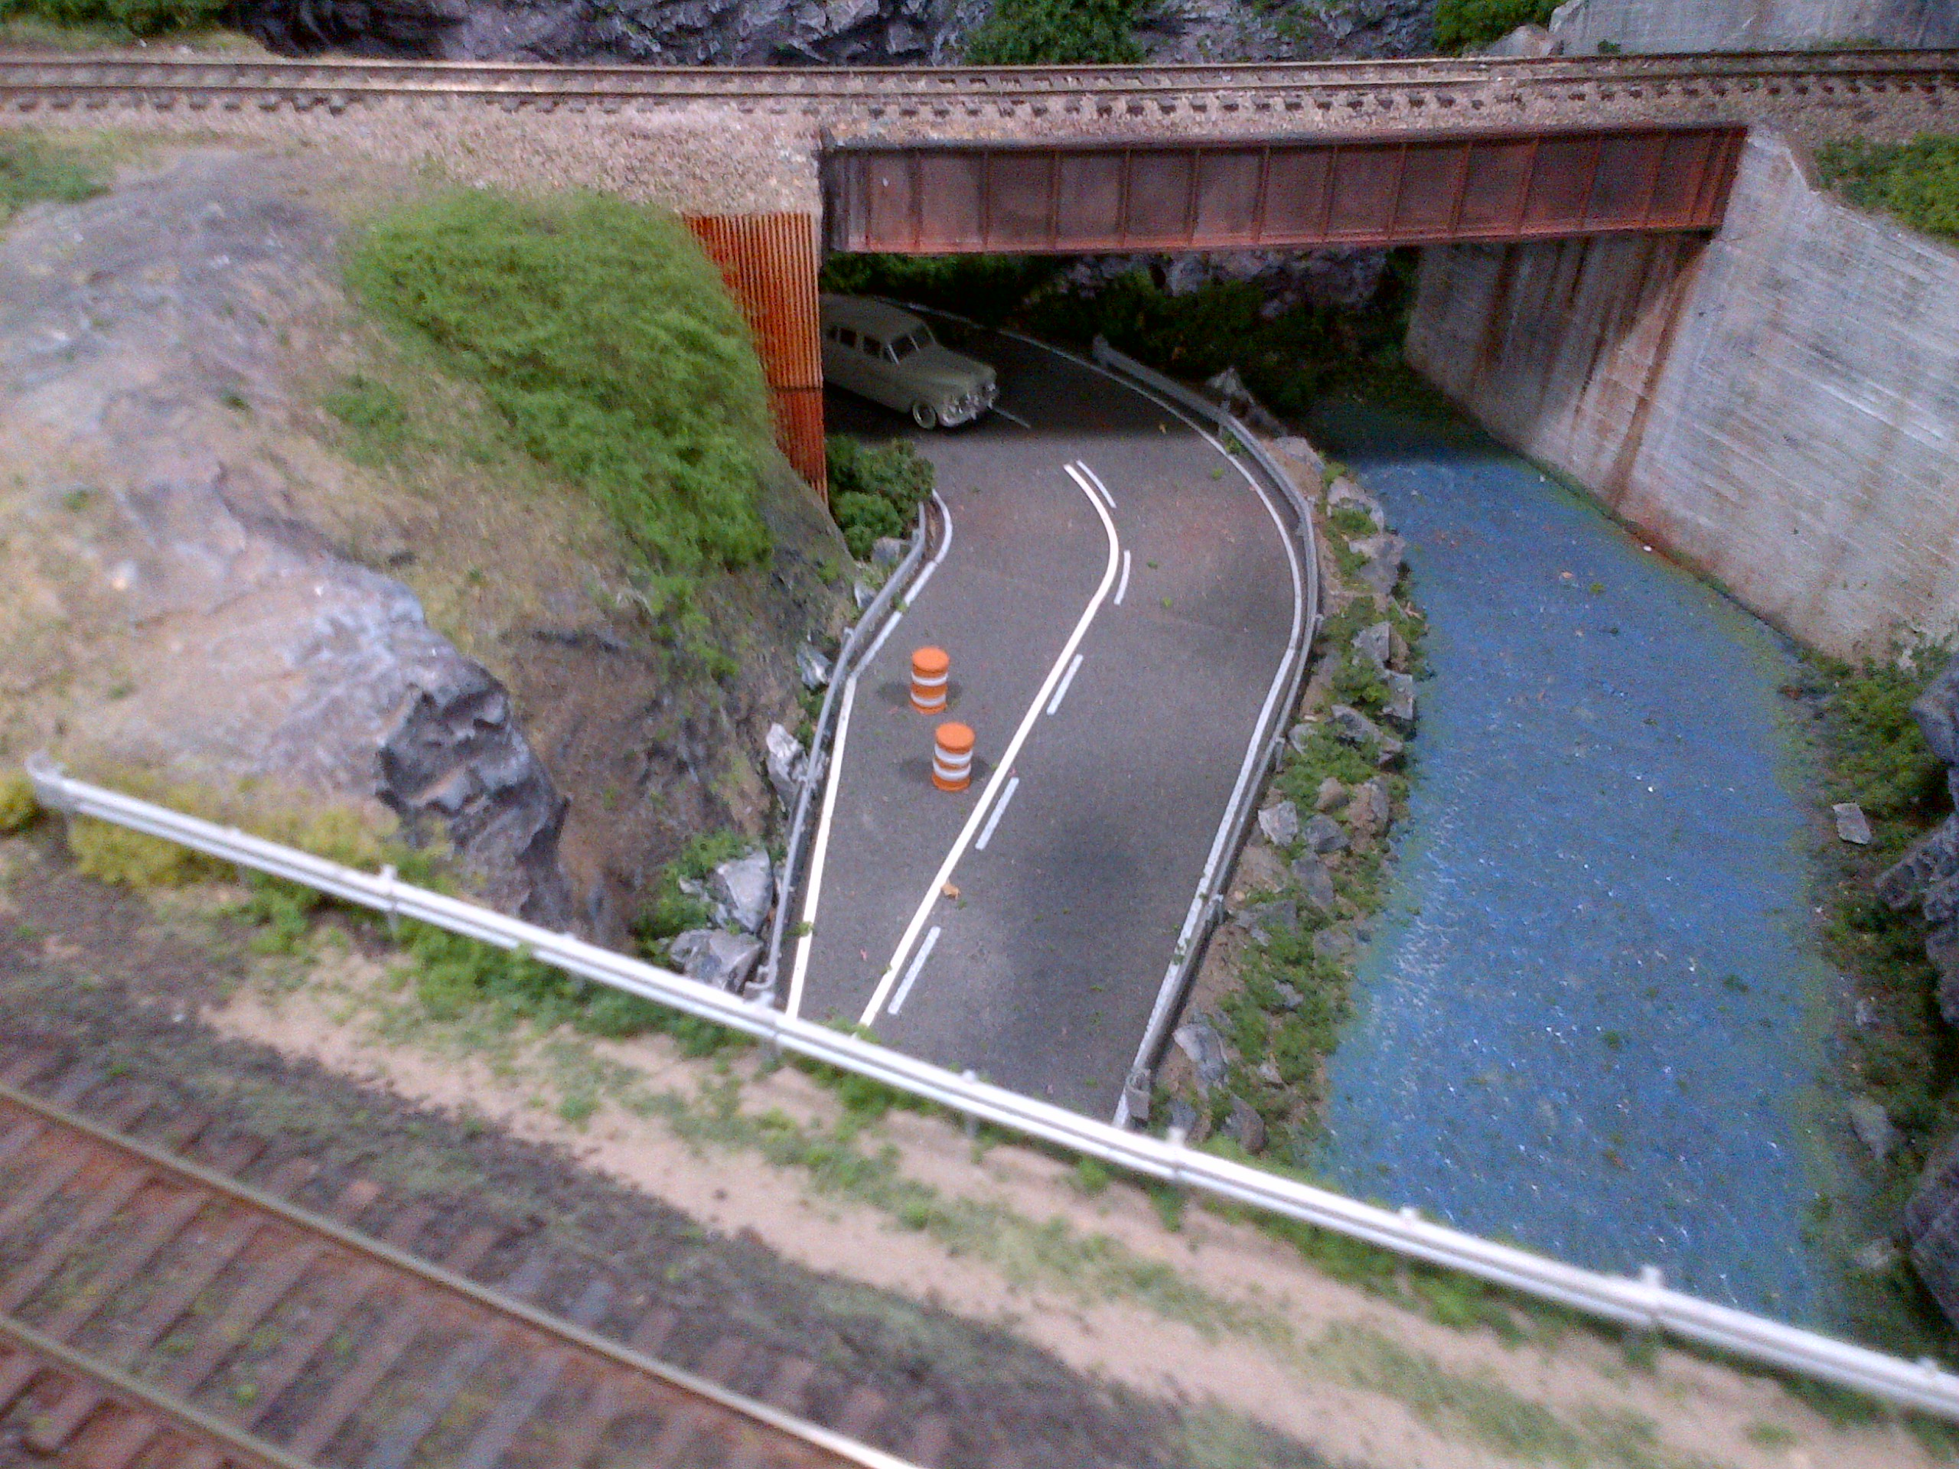
MORE STREET DETAIL

Slide 33
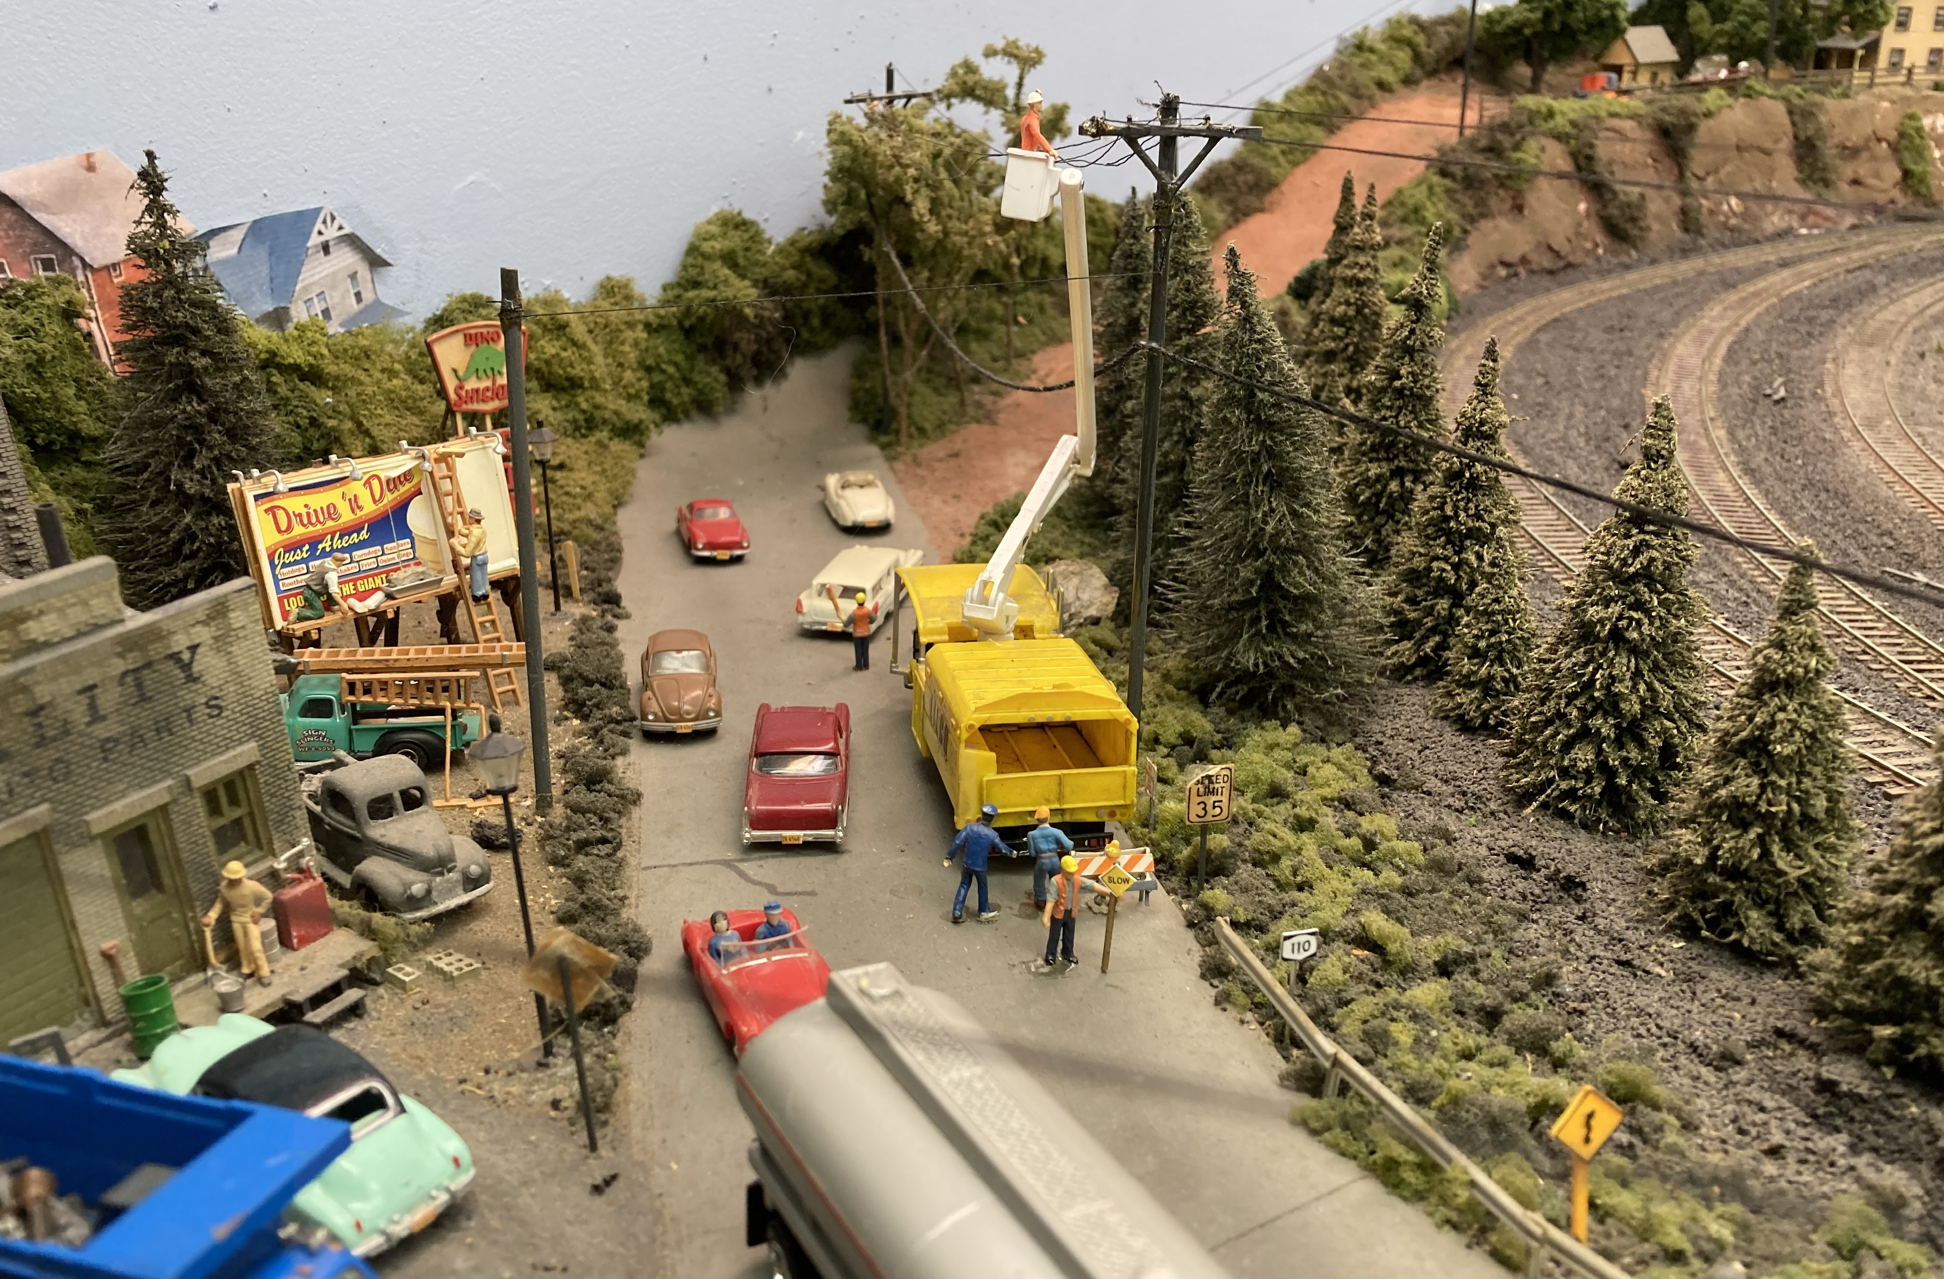
ADD SOME MINI-SCENES TO MAKE YOUR STREETS MORE INTERESTING

Slide 34
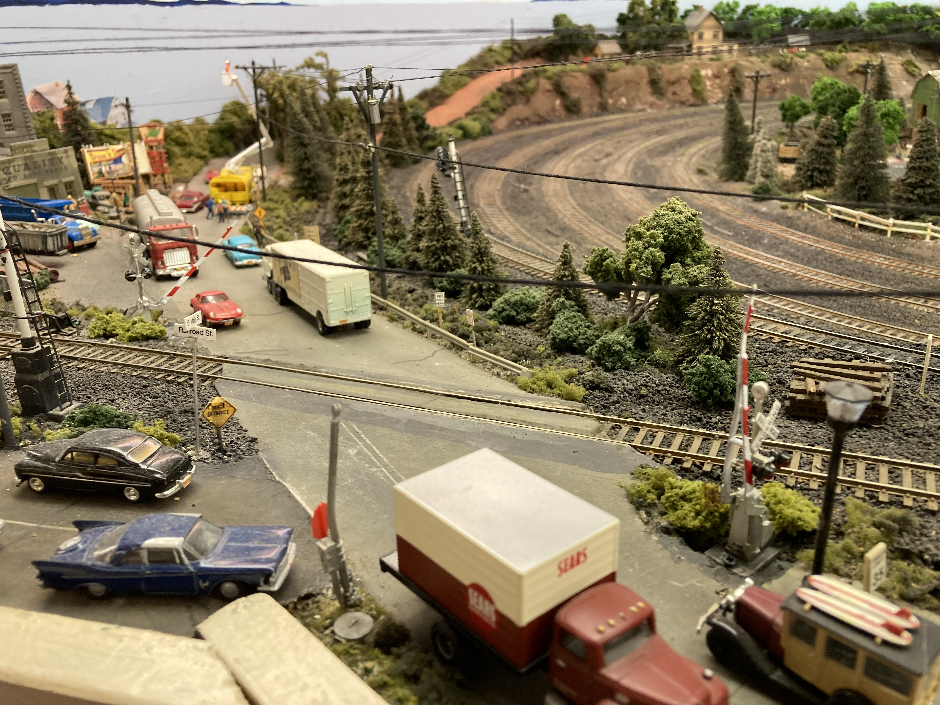
ADD CROSSING GATES AND FLASHERS AT GRADE CROSSINGS

Slide 35
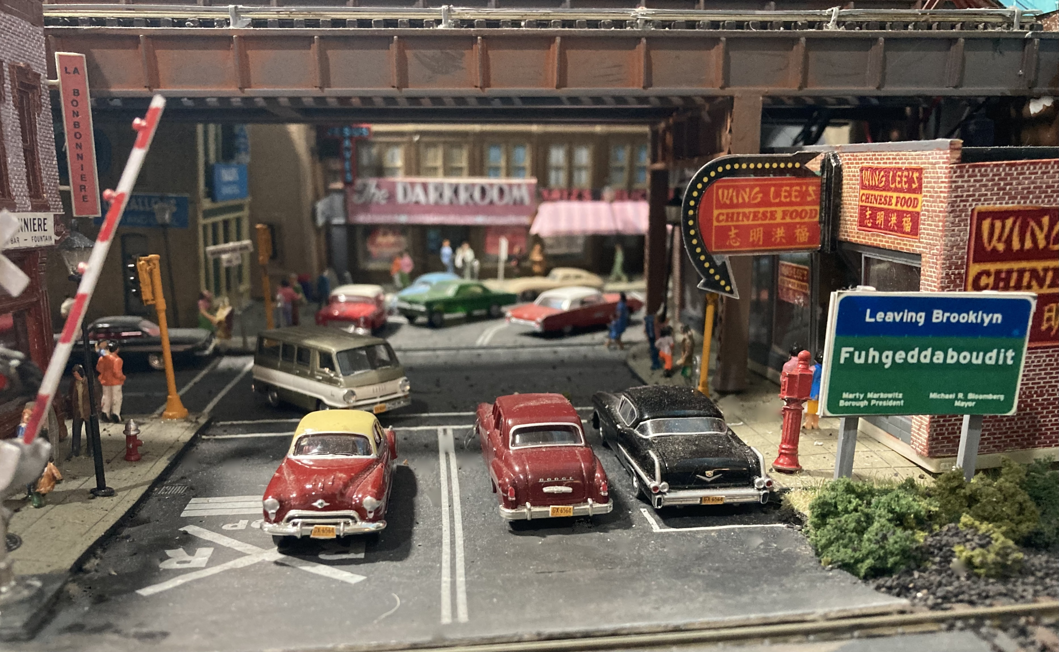
Add Some Detail to Vehicles such as License Plates

Slide 36
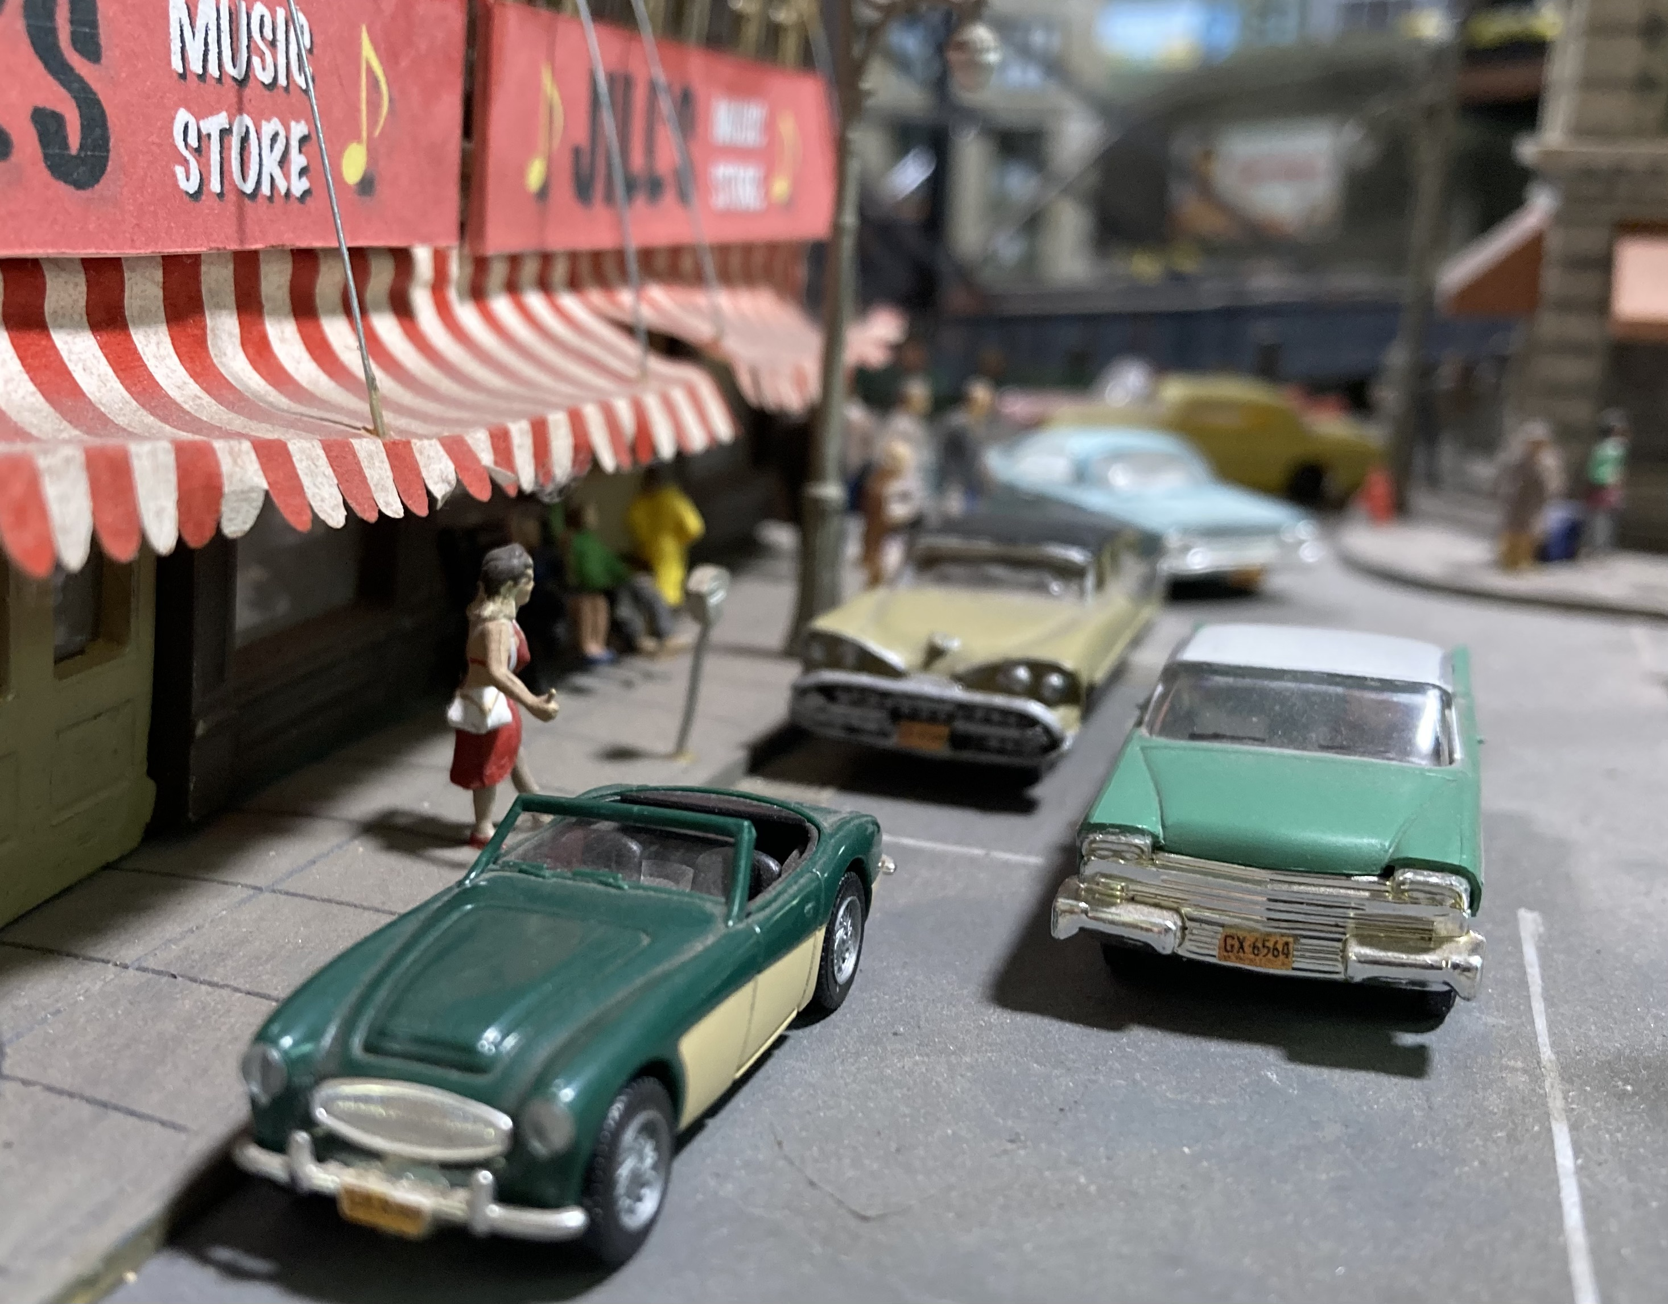

Slide 37
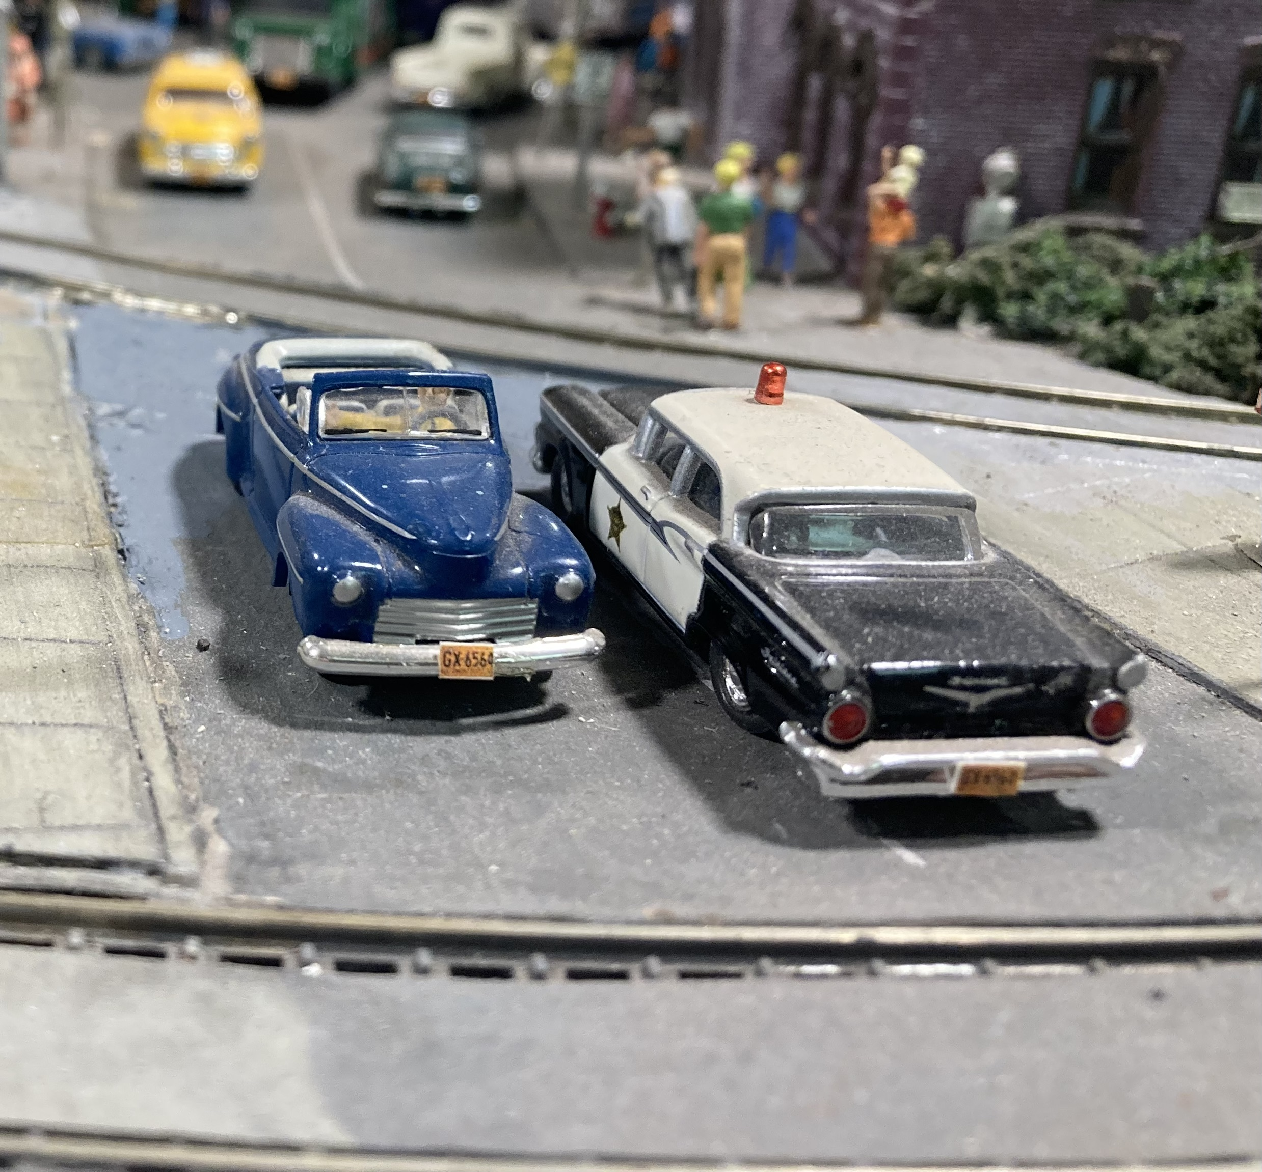

Slide 38
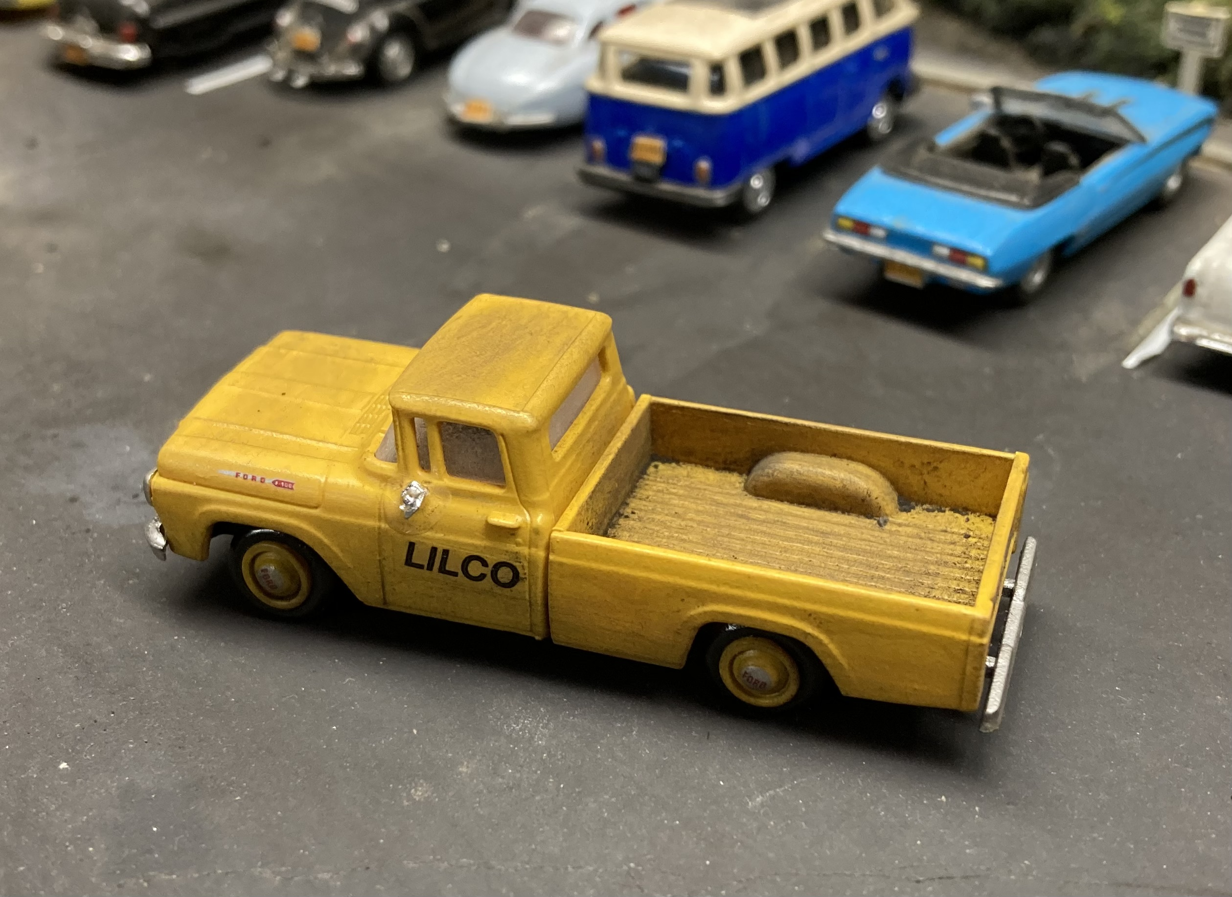
Customize Vehicles to Reflect Local Industries

Slide 39
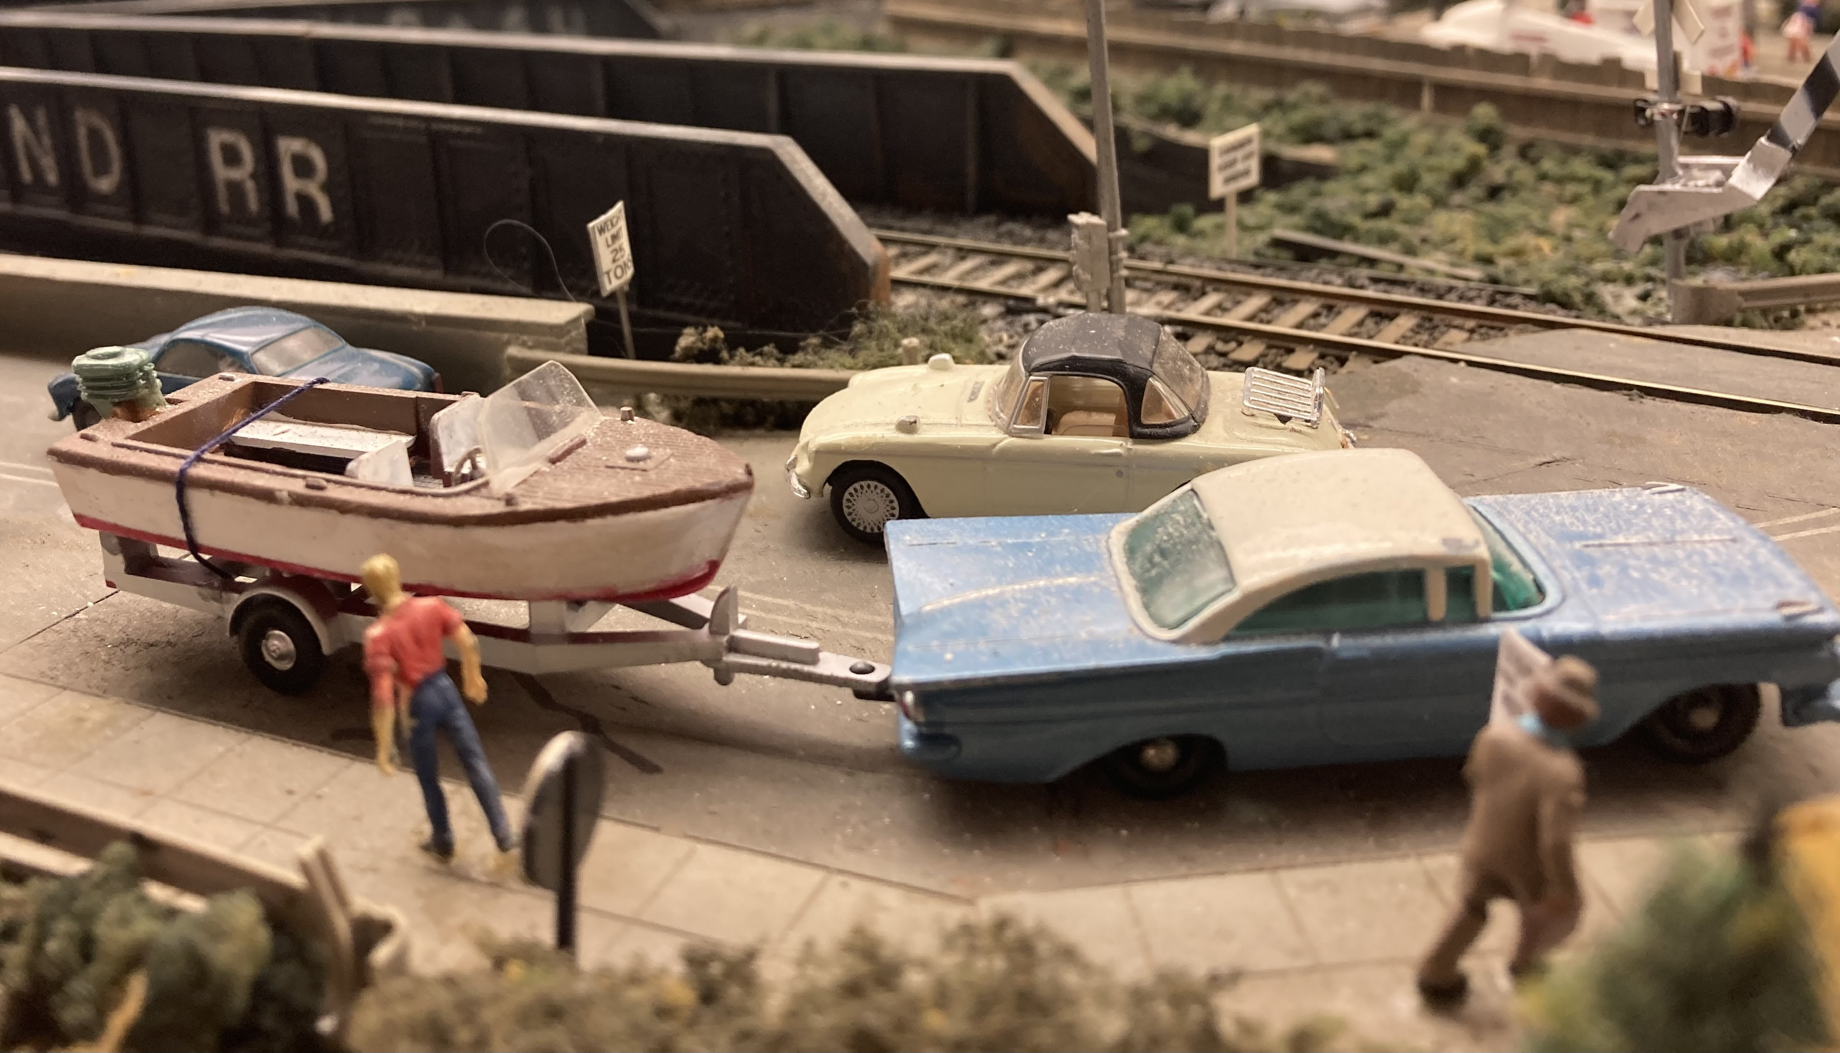
Cars Pulling Trailers Can Add to a Scene

Slide 40
BUILDING DETAILS
DETAILS ON BUILDINGS MAKE THEM INTERESTING
MOST COMMERCIAL BUILDINGS WITH FLAT ROOFS HAVE:
A MEANS TO ACCESS THE ROOF (ACCESS HATCH OR STAIRWELL)
PLUMBING VENTS
SKYLIGHTS
VARIOUS KINDS OF ROOF VENTS
AIR CONDITIONING UNITS
A/C DUCT WORK
ANTENNAS (BEFORE CABLE TV)
EQUIPMENT LEFT ON THEM (LADDERS, CANS, ETC.)
MANY FLAT ROOFS ARE COVERED WITH TAR PAPER OR GRAVEL

Slide 41
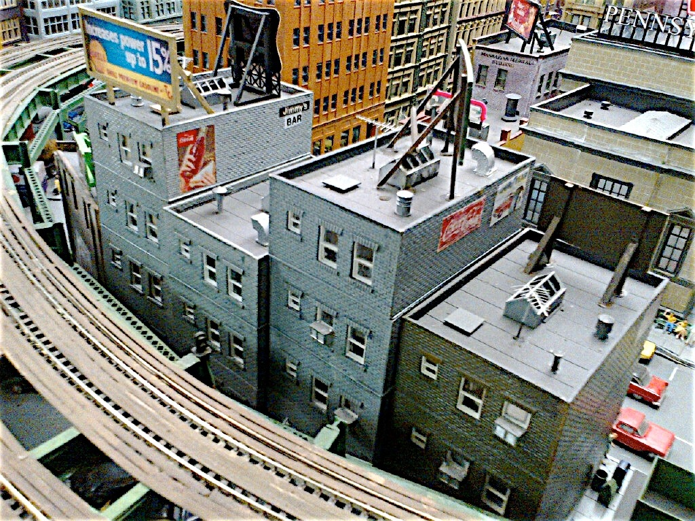
ROOF DETAILS

Slide 42
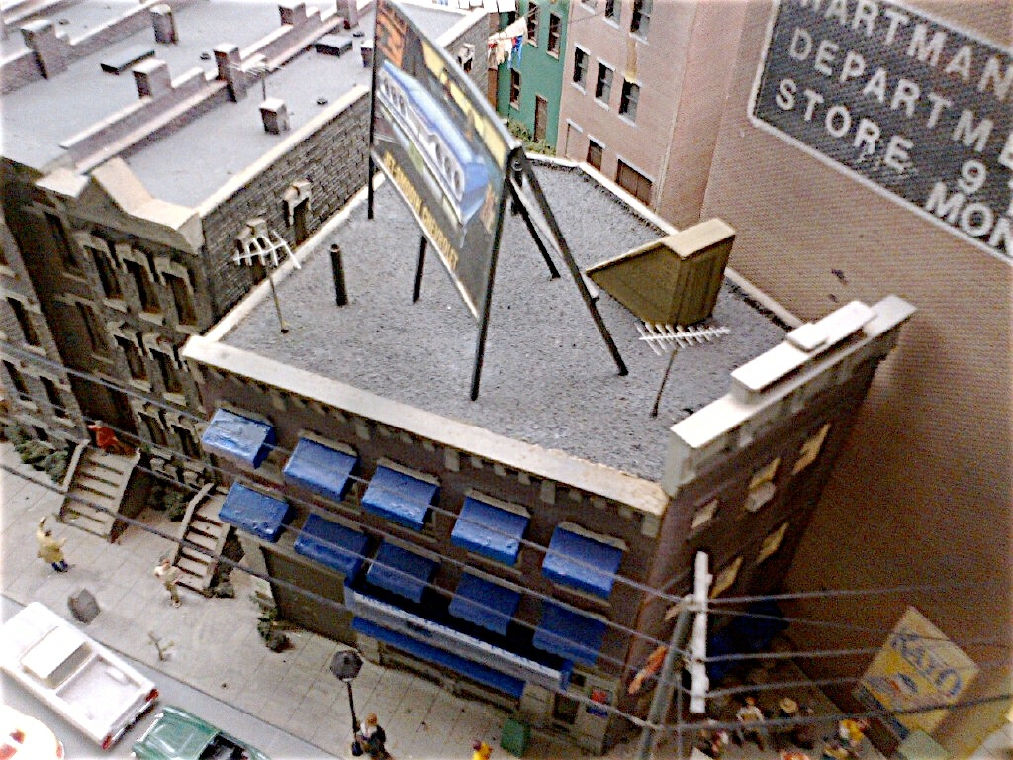

Slide 43
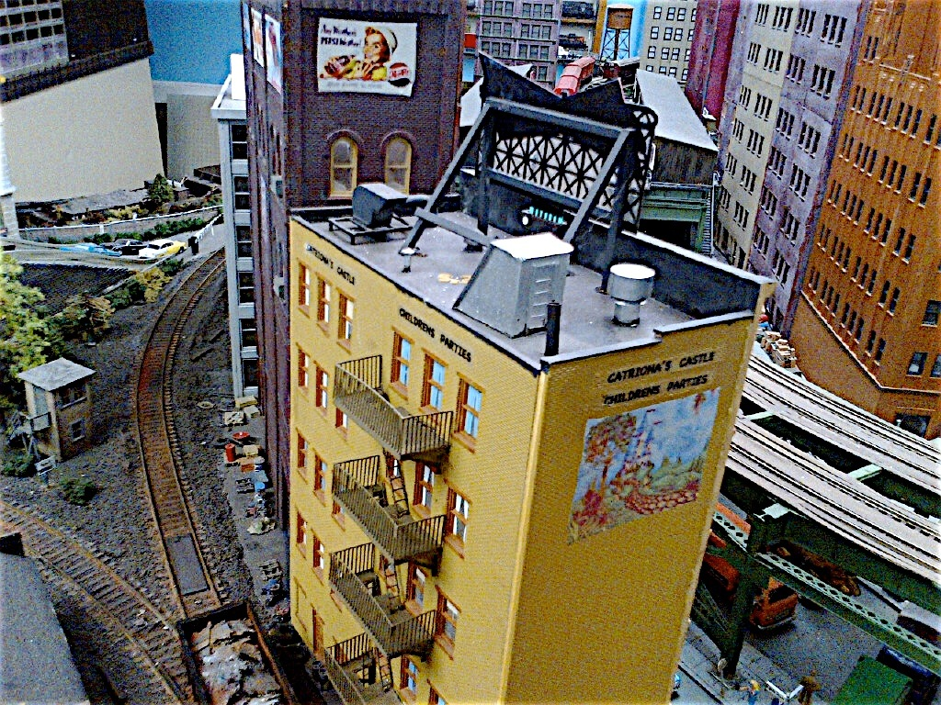

Slide 44
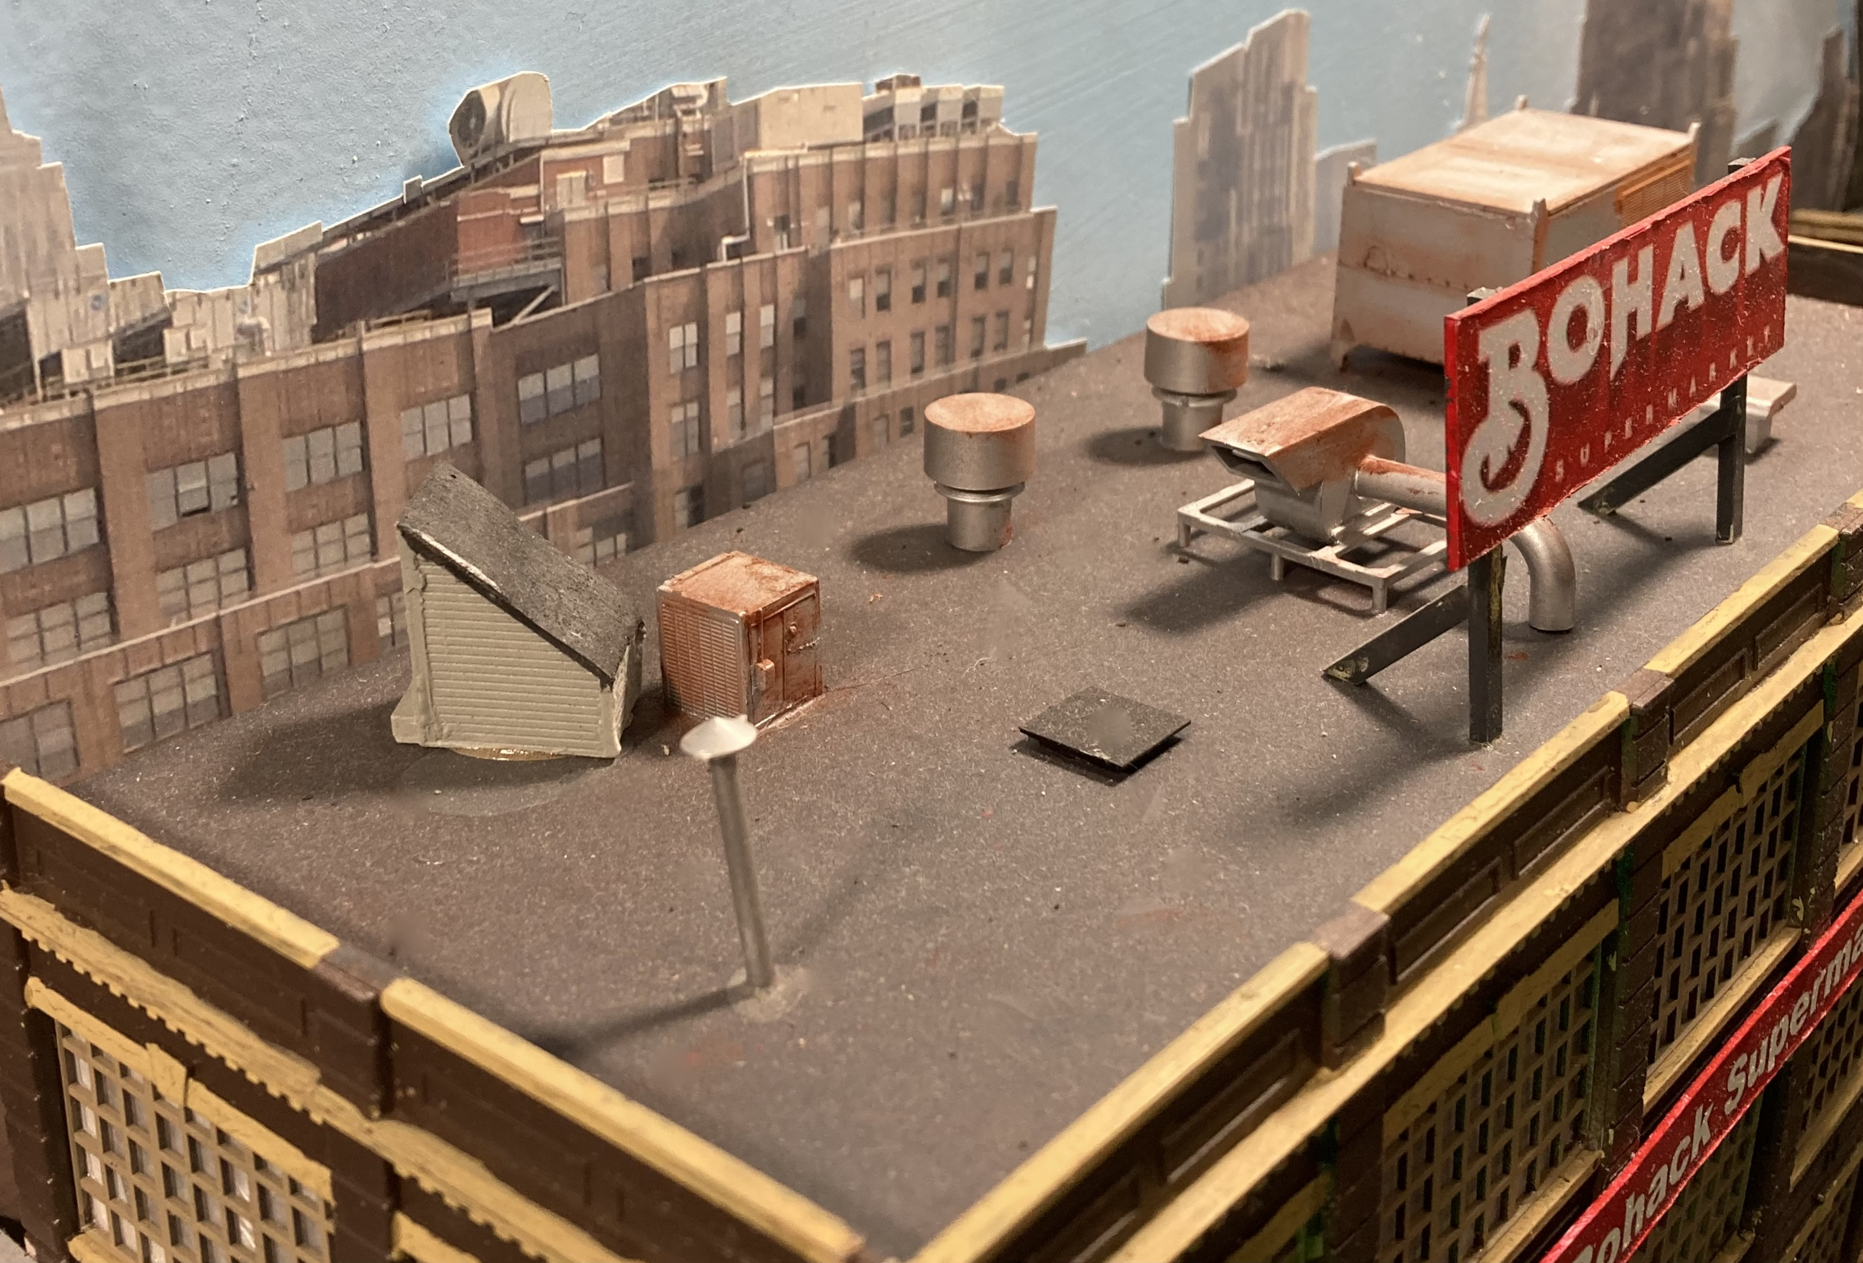

Slide 45
BUILDING SIDE DETAILS
WINDOW TREATMENTS. ADD CURTAINS OR SHADES
I PUT WAX PAPER BEHIND THE CLEAR GLAZING. IT LETS LIGHT IN OR OUT BUT BLOCKS THE VIEW INSIDE
PRIOR TO THE ADVENT OF CENTRAL A/C, WINDOWS OFTEN HAD WINDOW A/C UNITS IN THEM OR WINDOW FANS
WINDOW AWNINGS WERE ALSO USED TO KEEP OUT DIRECT SUNLIGHT
MOST SMALLER BUILDINGS, BOTH COMMERCIAL AND RESIDENTIAL, HAVE ELECTRICAL LINES (OR LINE) COMING FROM A UTILITY POLE. THEY CONNECT ABOVE THE ROOF AND TRAVEL DOWN A METAL CONDUIT TO AN ELECTRIC METER

Slide 46
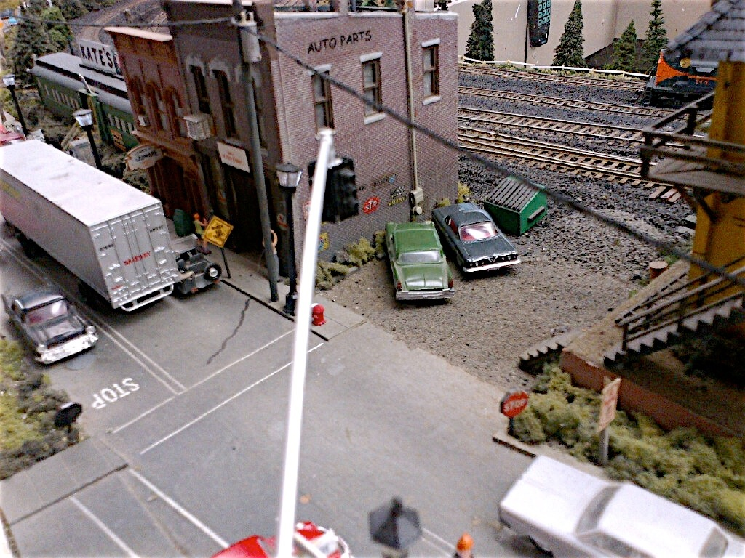
ELECTRIC METER ON SIDE OF BUILDING. A/C IN WINDOW

Slide 47
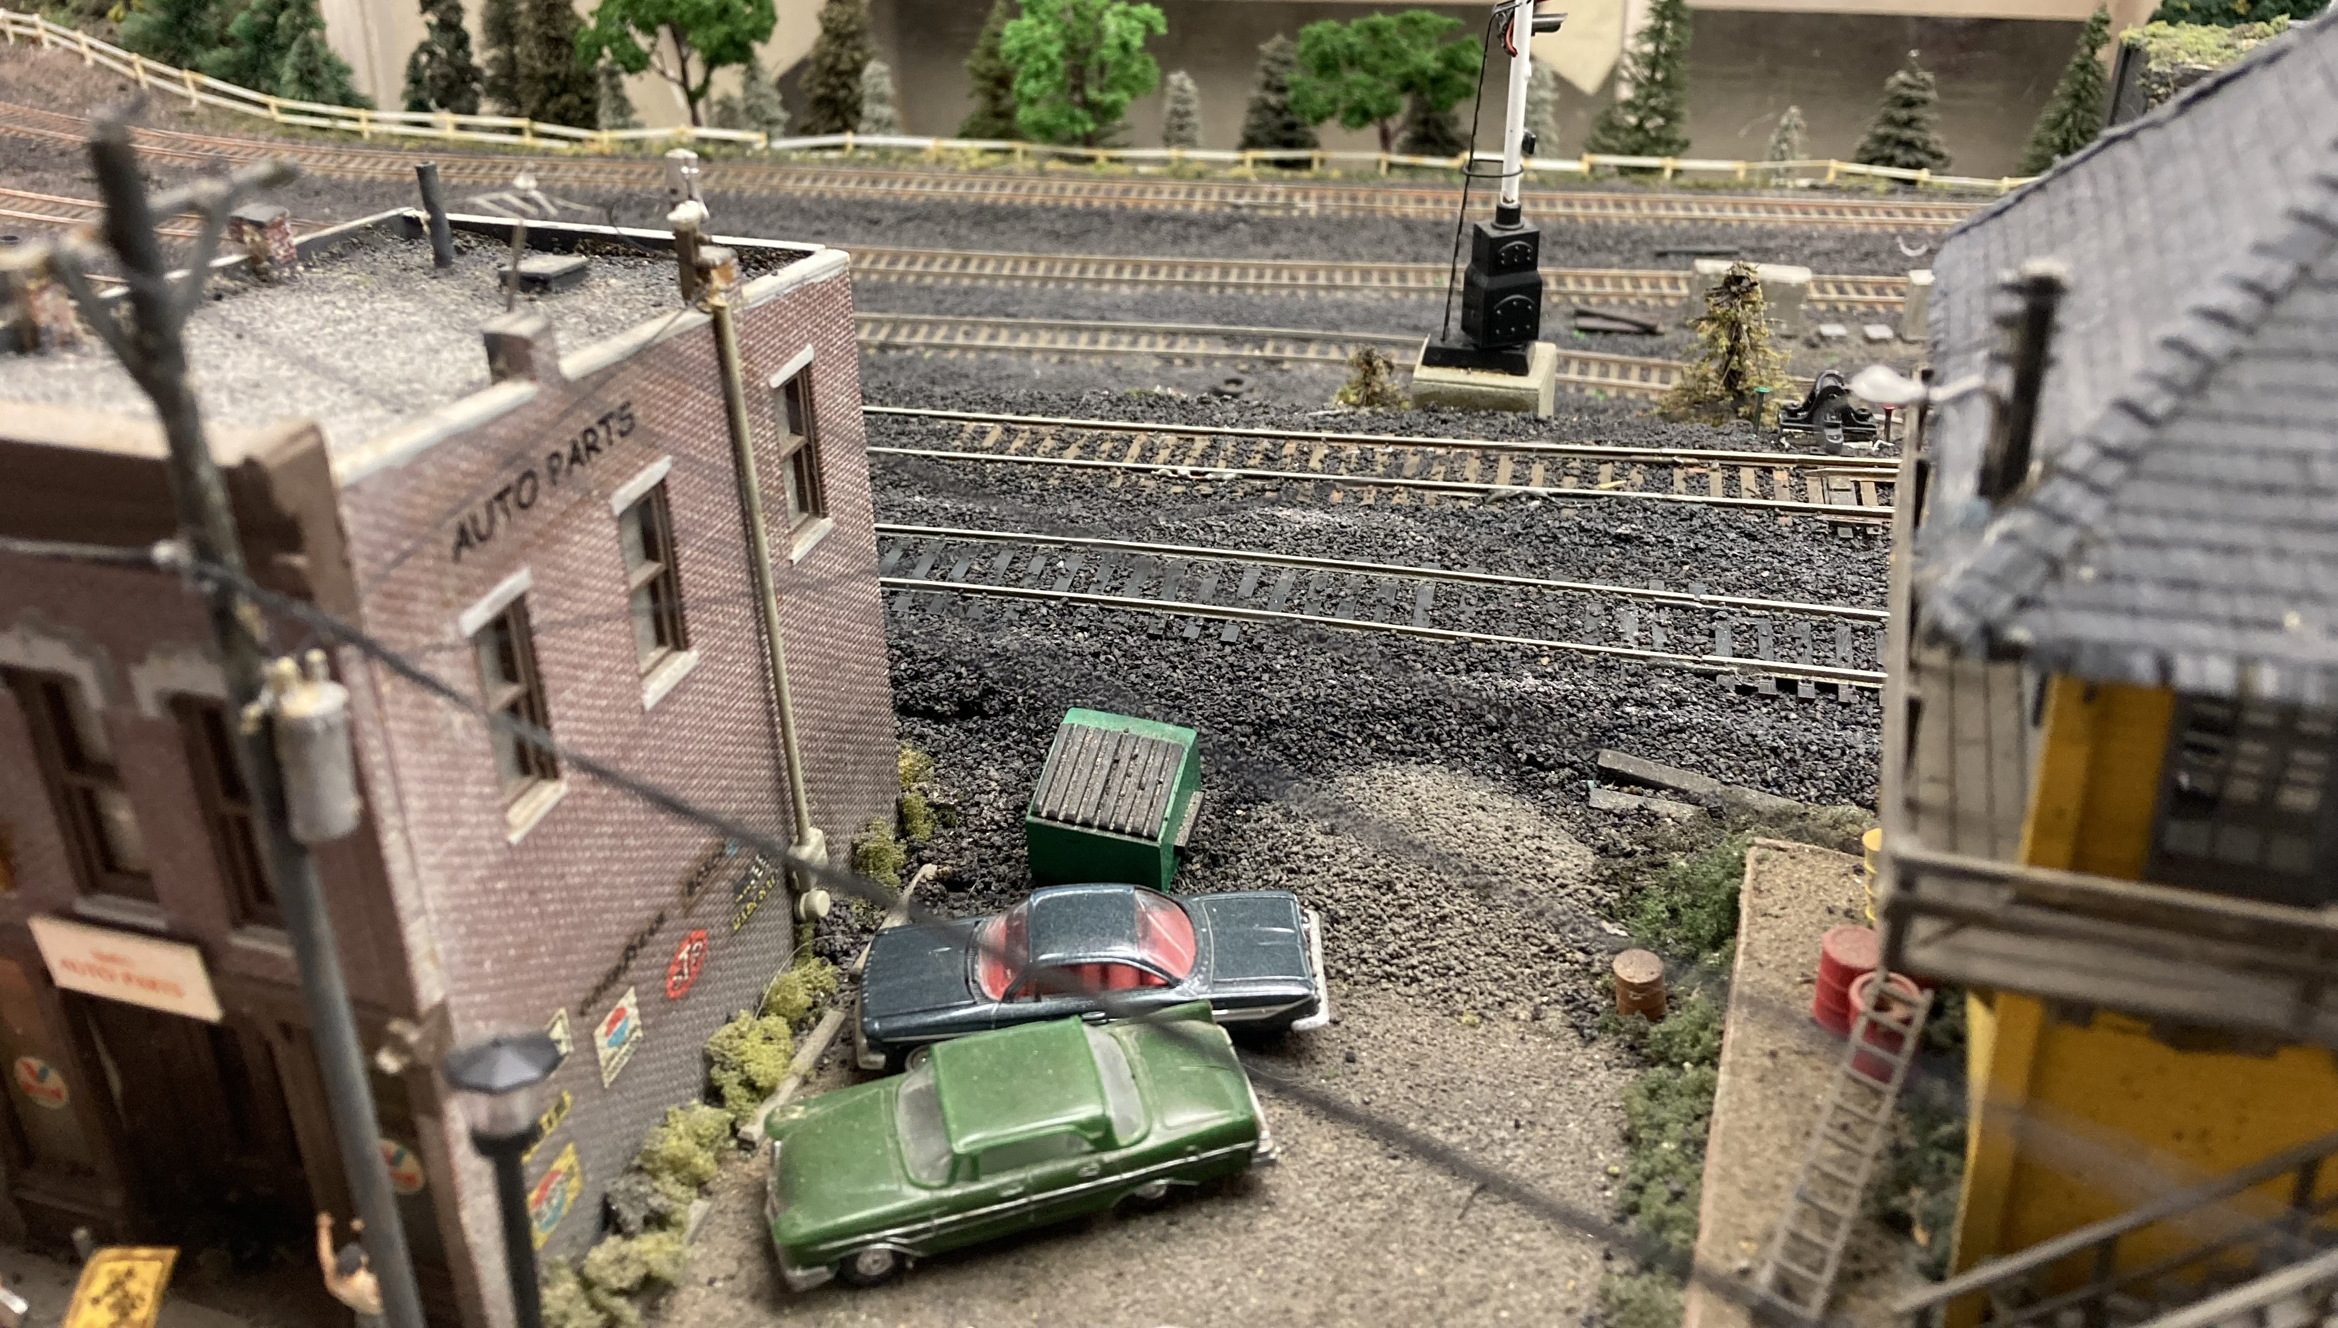
ADD POWER HEADS TO BUILDINGS
POWER HEADS

Slide 48
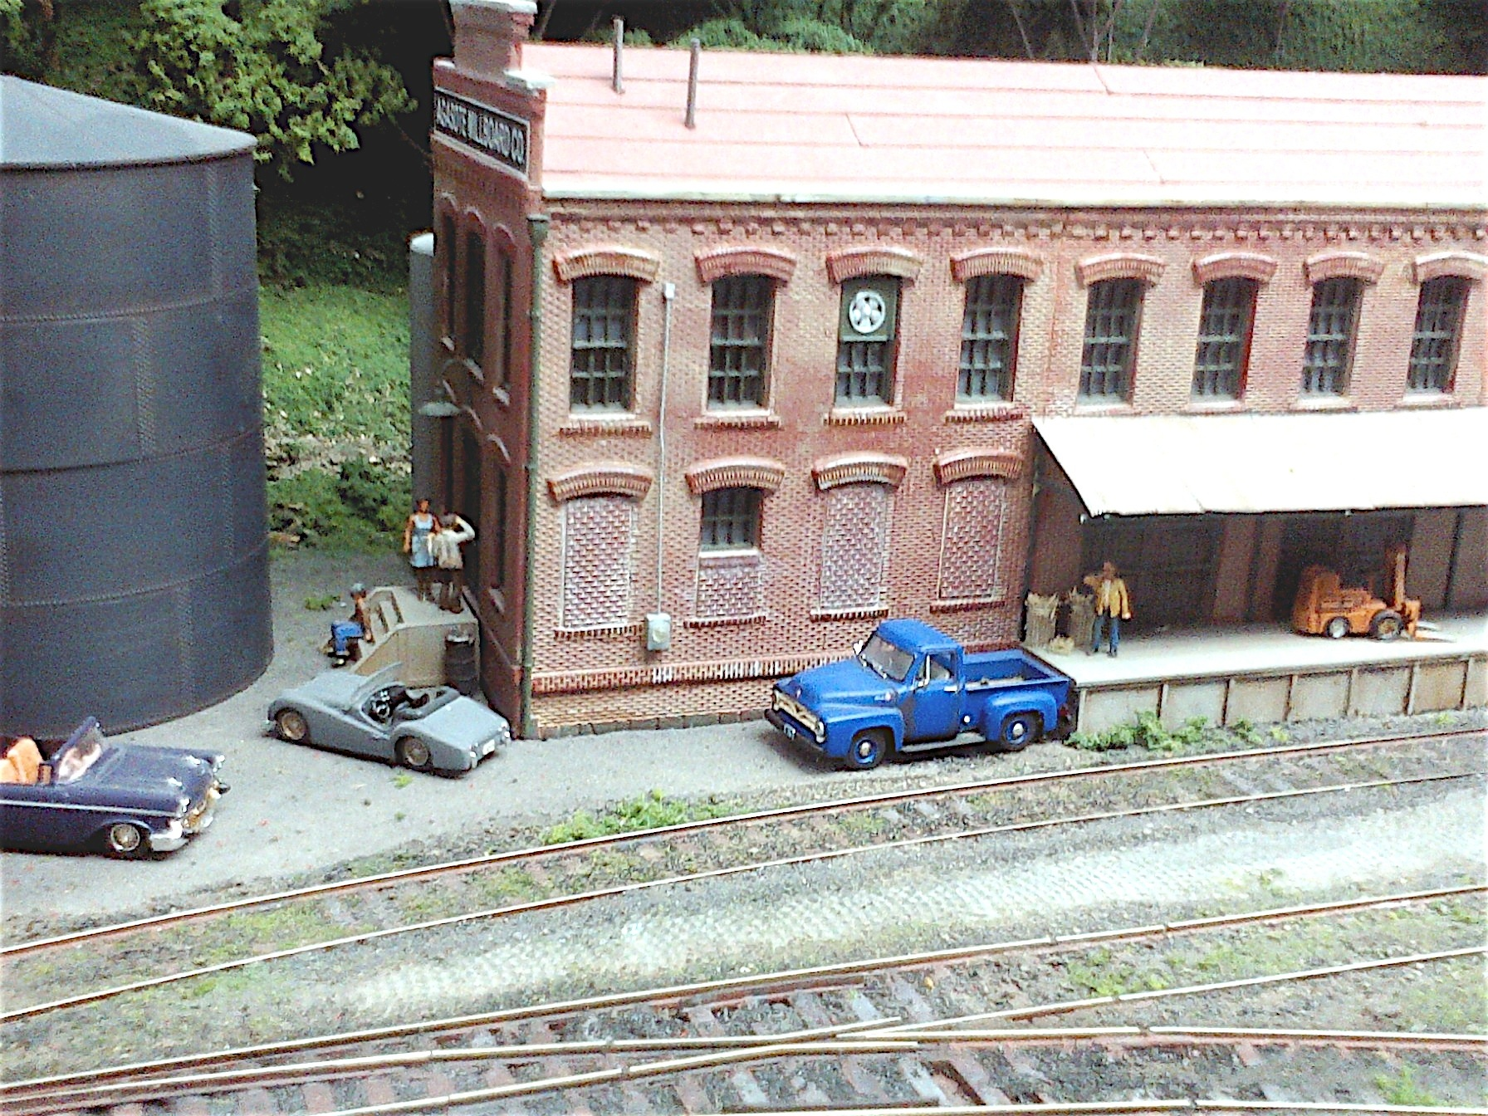
BUILDING DETAILS
ON BERNIE HALLORAN’S LAYOUT

Slide 49
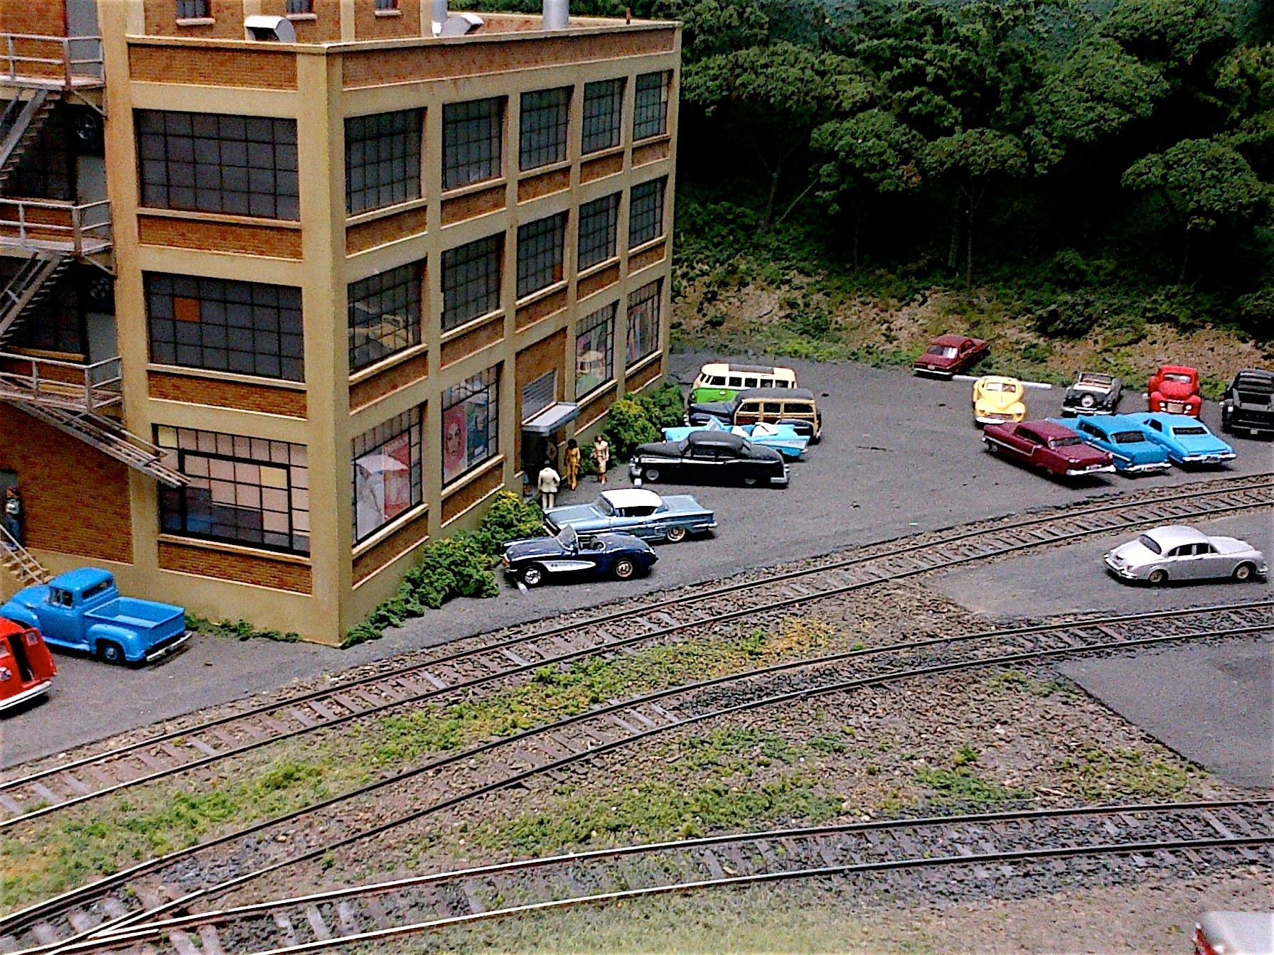
MORE BUILDING DETAILS

Slide 50
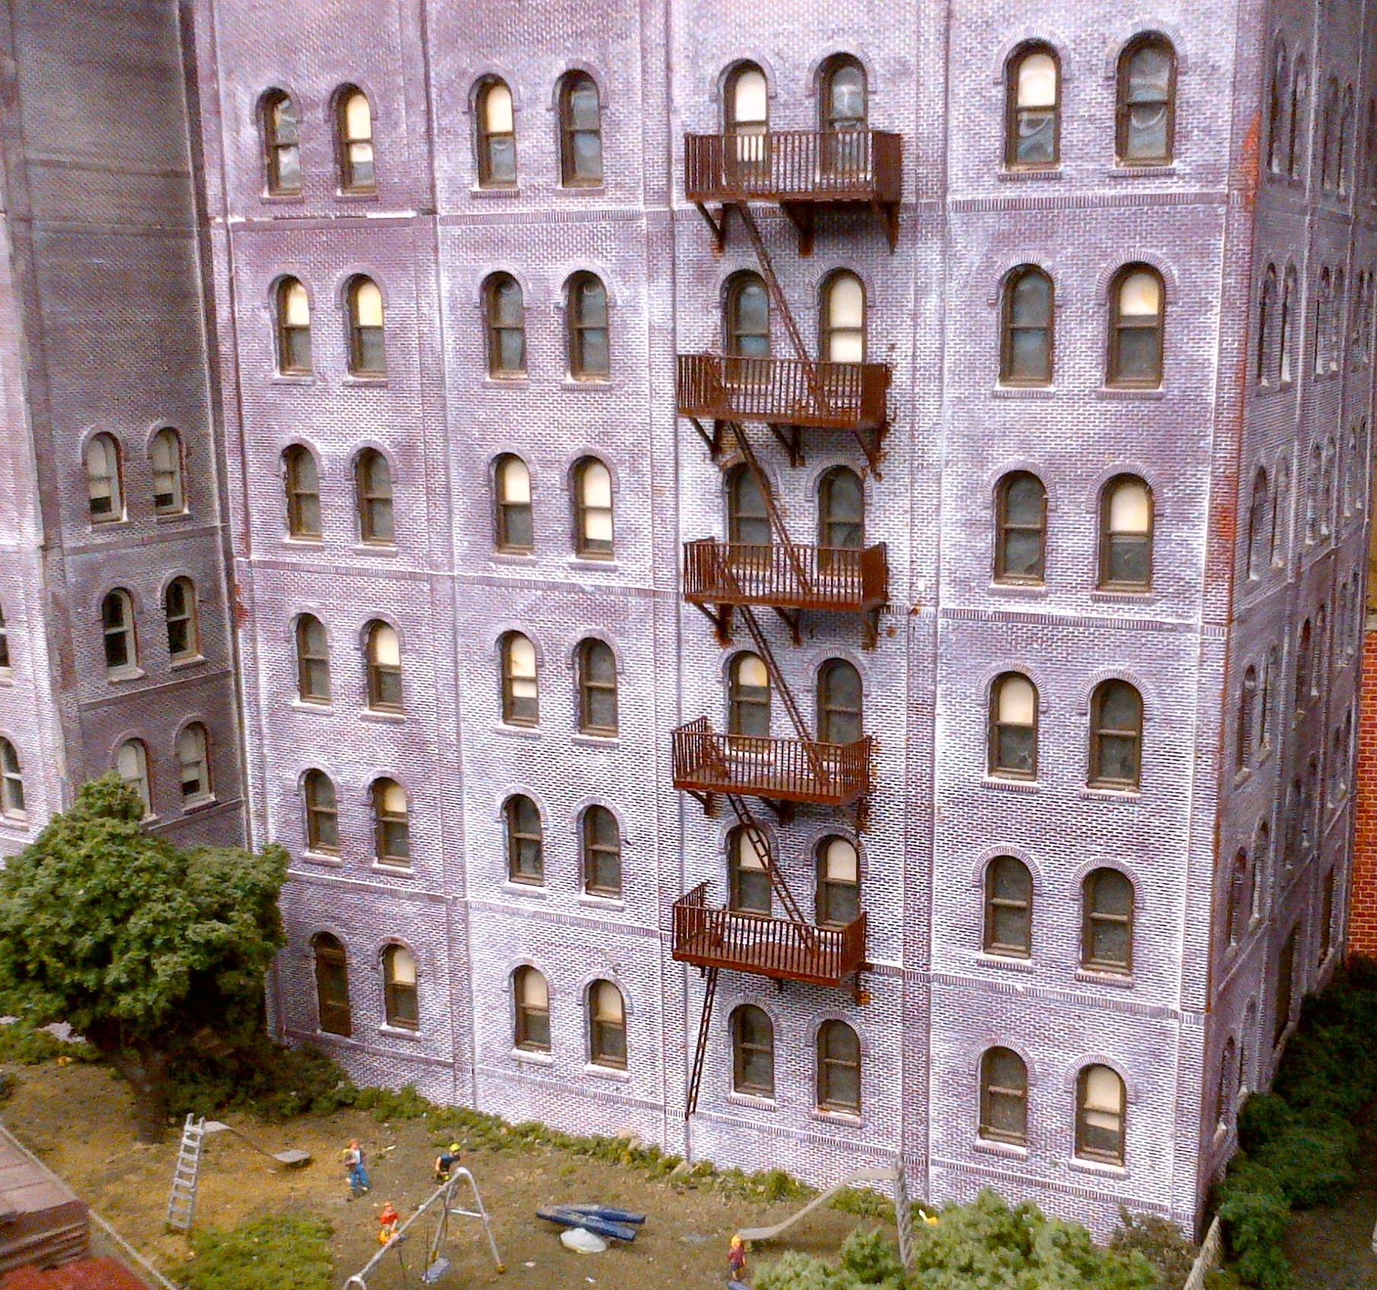
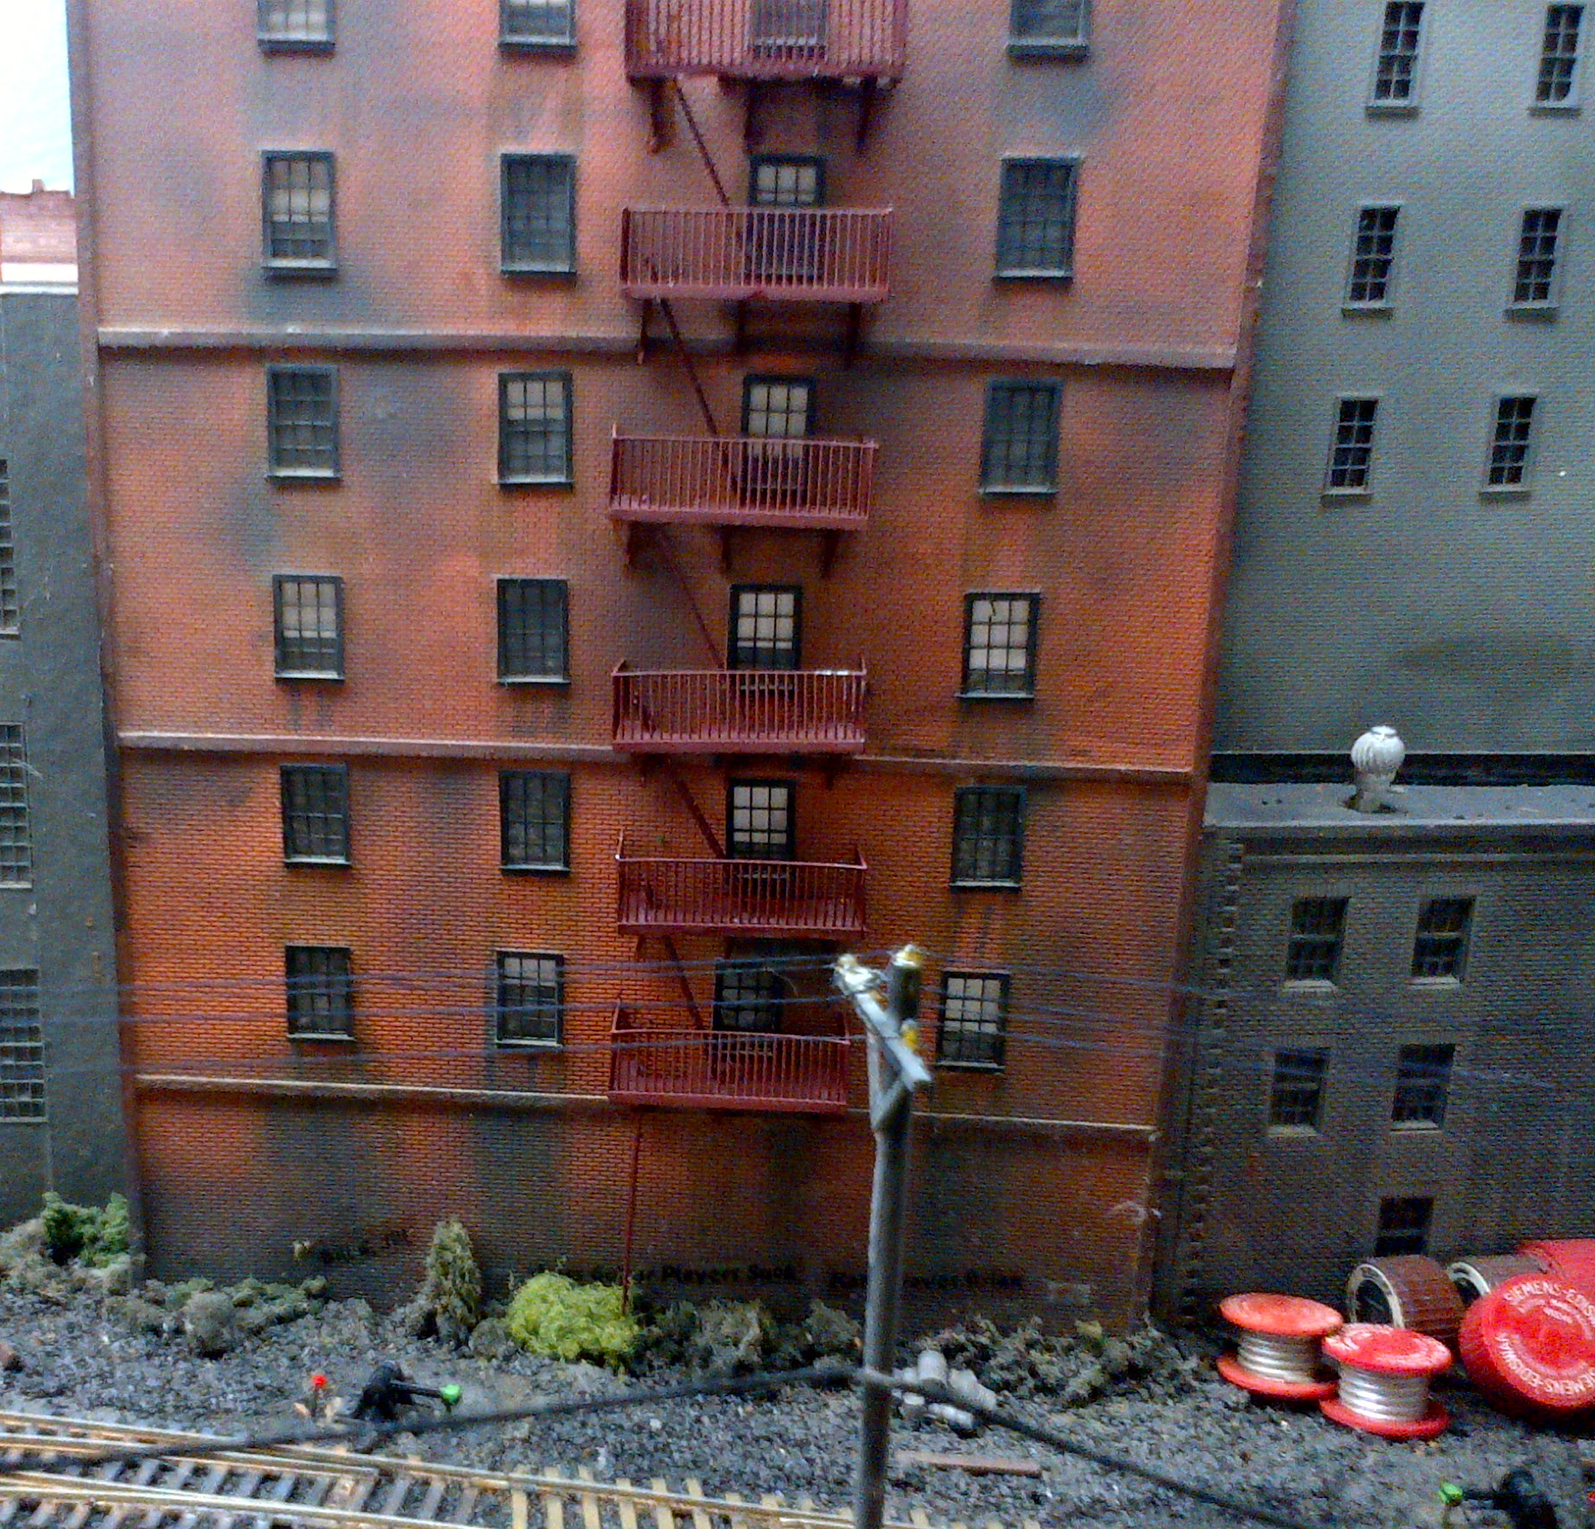
FIRE ESCAPES PROVIDE
INTERESTING DETAIL

Slide 51
TRACK DETAILS
MOST OF US ARE FAMILIAR WITH TRACK DETAILS, SO I WON’T SPEND A LOT OF TIME ON THEM
RAILROADS, LIKE REGULAR ROADS, HAVE SIGNS. ADD WHISTLE, YARD LIMIT, AND SPEED SIGNS, ETC., WHERE APPROPRIATE
WEATHER YOUR RAILS. REAL RAILS ARE NOT SHINY EXCEPT ON THE TOP
REPLACEMENT (OR REPLACED) TIES ARE OFTEN LEFT NEXT TO THE TRACK
BALLAST IS USUALLY NOT CLEAN. SOME WEATHERING ON LIGHTER
COLORED BALLAST HELPS.
TRASH (E.G., OLD TIRES, BARRELS) IS OFTEN NEXT TO TRACKS
SIGNALS, WHETHER FUNCTIONAL OR NOT, ADD TO REALISM

Slide 52
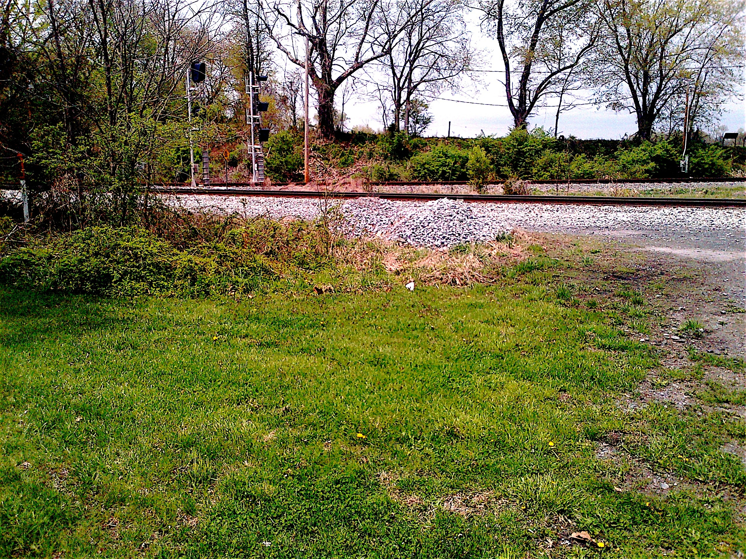
A WYE JUST SOUTH OF FREDERICK, MD.
NOTE THE TWO SIGNALS AND BALLAST PILES

Slide 53
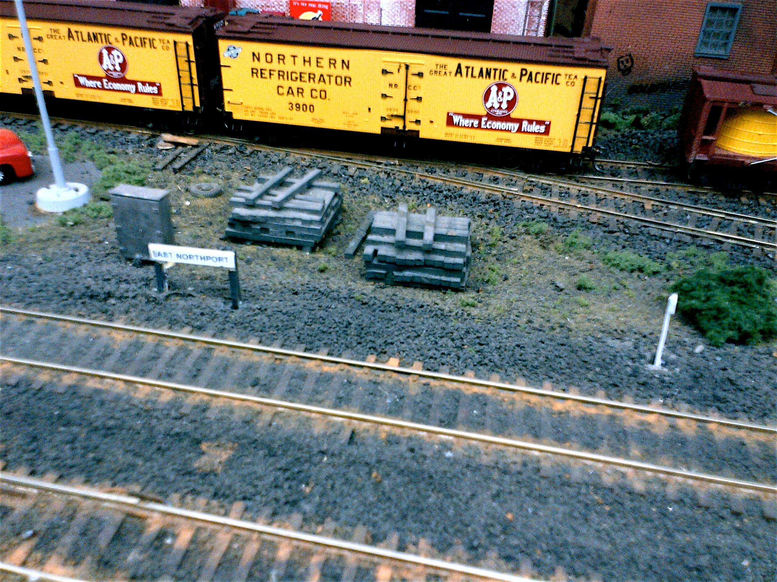
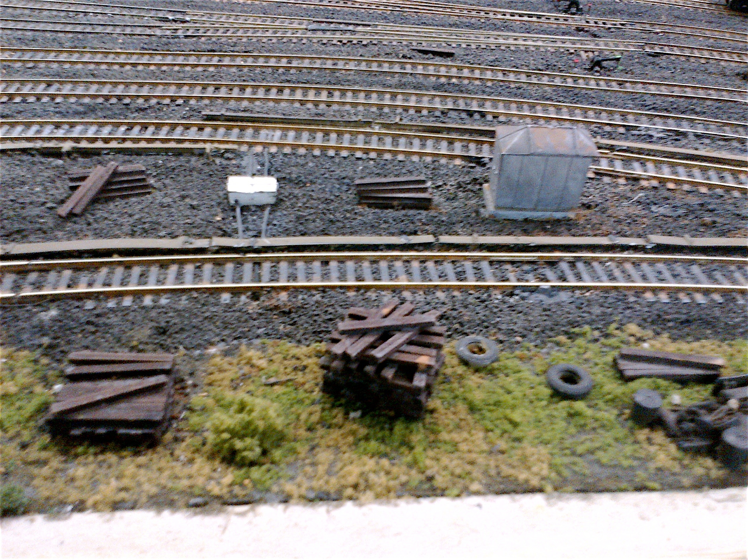
ELECTRICAL BOX, TIE STACKS, STATION SIGN,
AND WHISTLE SIGN

Slide 54
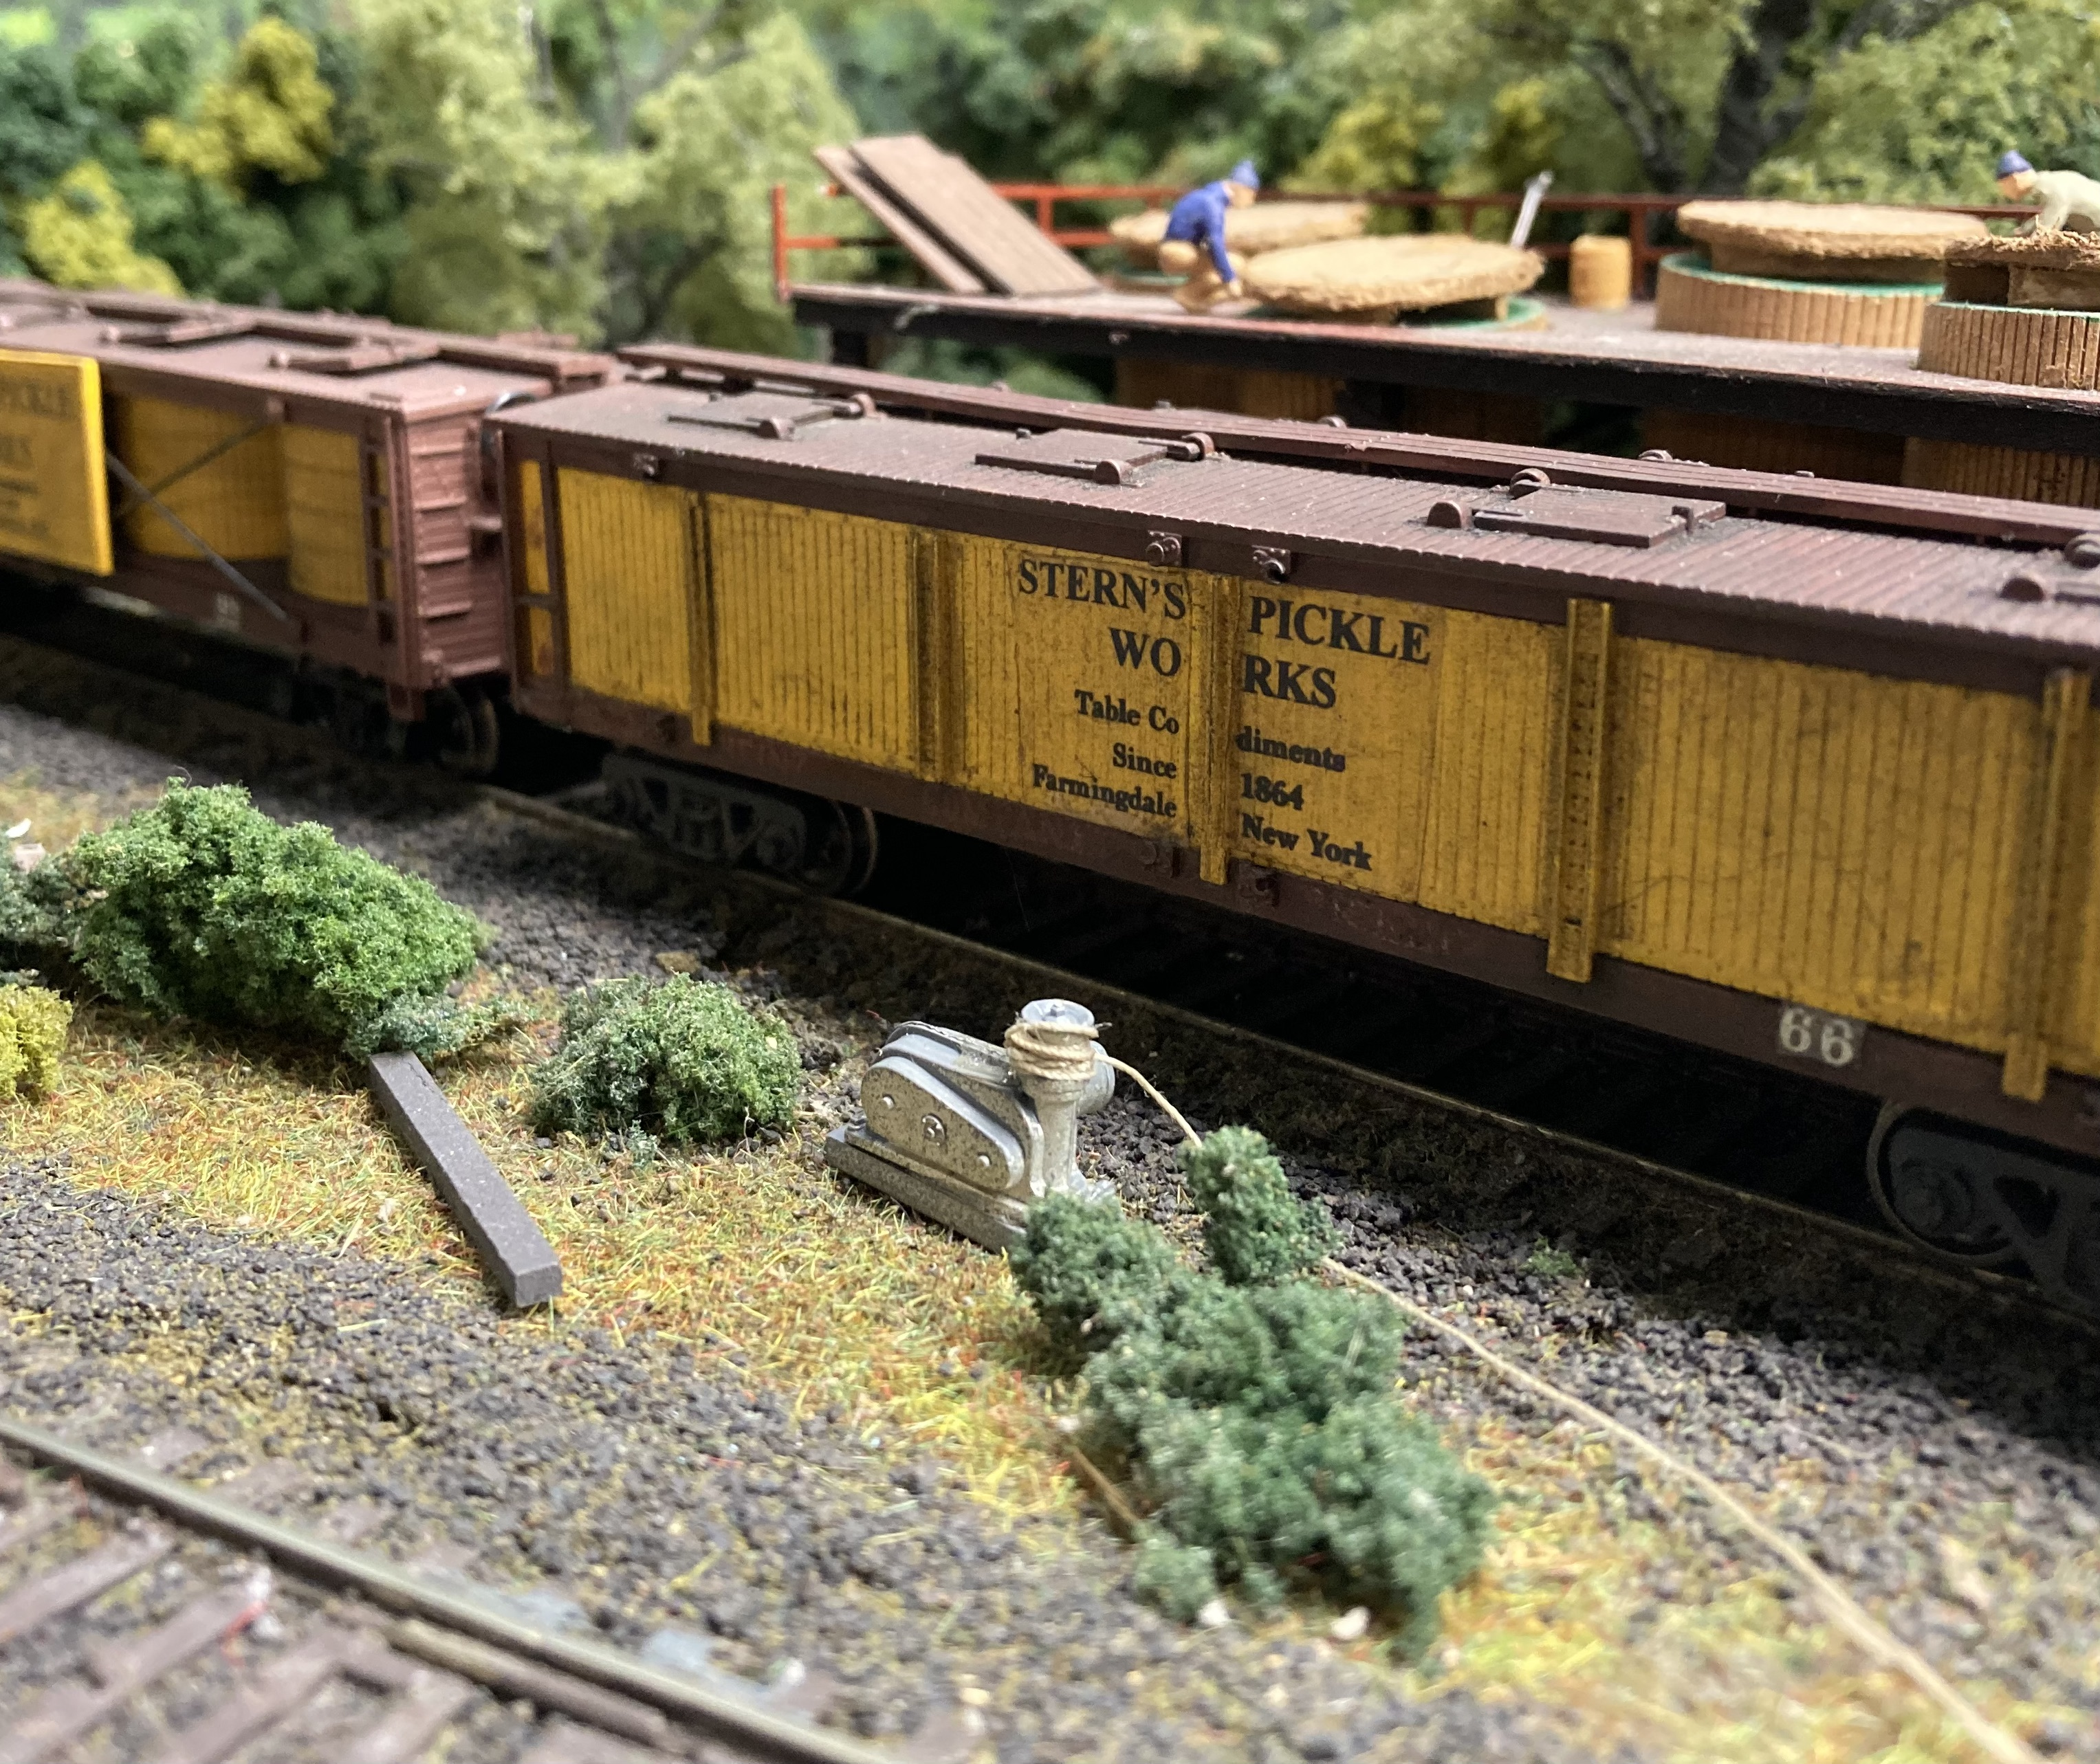
ADD A CAR PULLER ON SIDINGS WHERE ALL THE FREIGHT CARS CANNOT BE NEXT TO THE LOADING DOCKS

Slide 55
SIGNS
SIGNS ARE EVERYWHERE
AS YOU DRIVE AROUND, IT IS RARE WHEN YOU ARE NOT WITHIN SIGHT OF AT LEAST ONE SIGN
SIGNS ARE ALONG ROADS TO INFORM DRIVERS
SIGNS ARE ALSO ALONG ROADS TO ADVERTISE
SIGNS ARE ON BUILDINGS
SIDES
ROOFS
WINDOWS

Slide 56
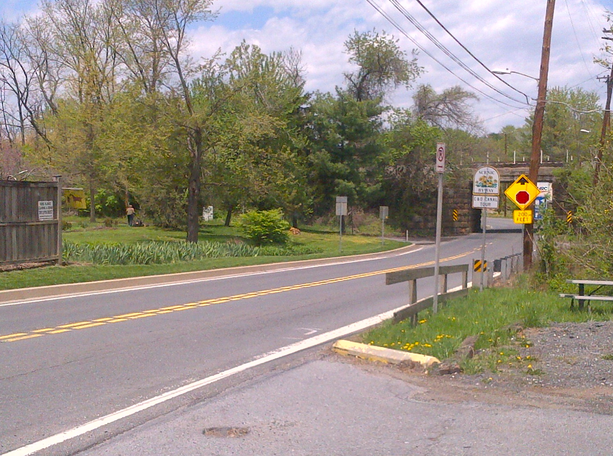
A PLETHORA OF SIGNS AS YOU APPROACH THE RAILROAD UNDERPASS
ON RT 28 IN RURAL DICKERSON, MARYLAND

Slide 57
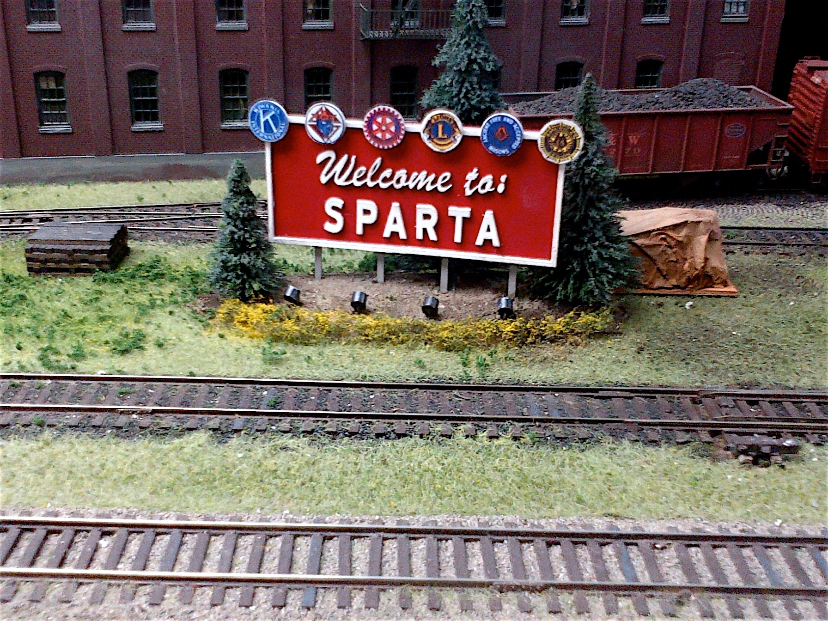
AN INTERESTING SIGN ON BERNIE HALLORAN’S LAYOUT

Slide 58
NOTE THE DOUBLE ARROW ON THE GUARD RAIL

Slide 59
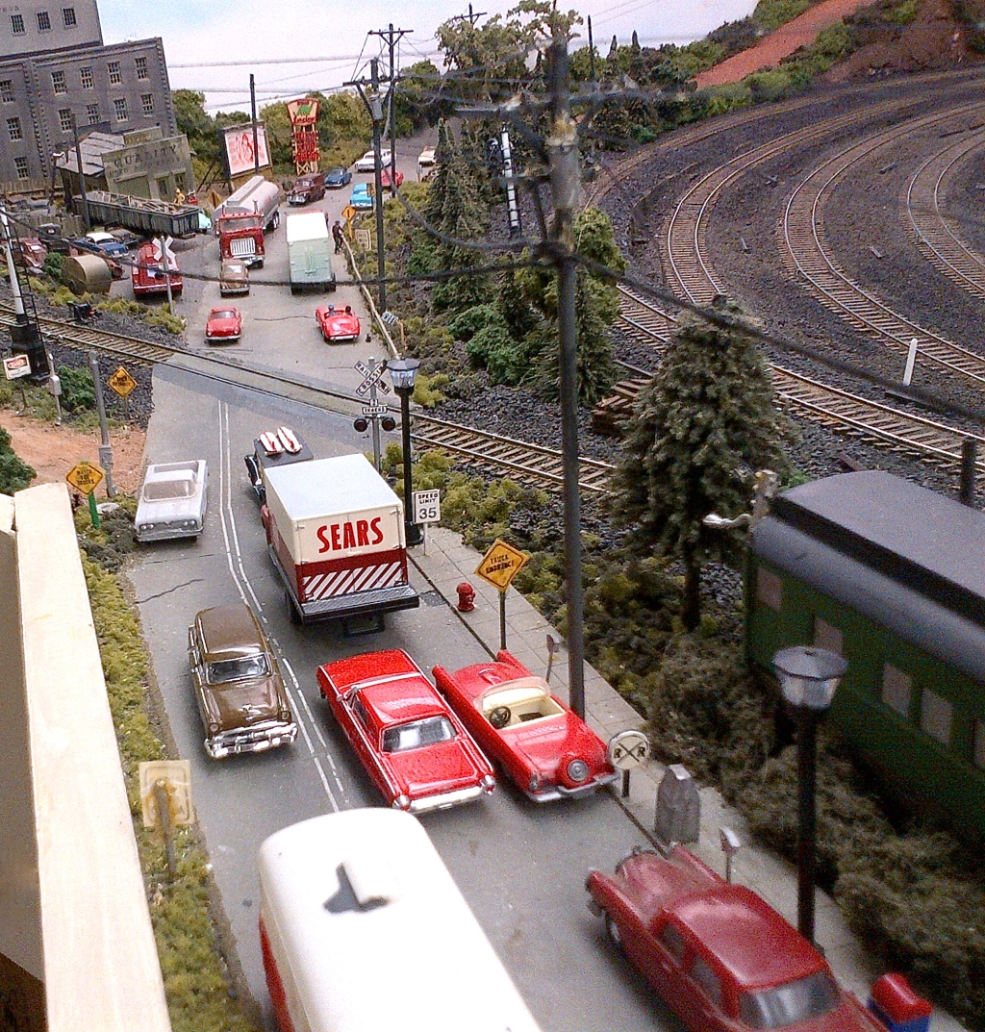
SIGNS ON
MY LAYOUT

Slide 60
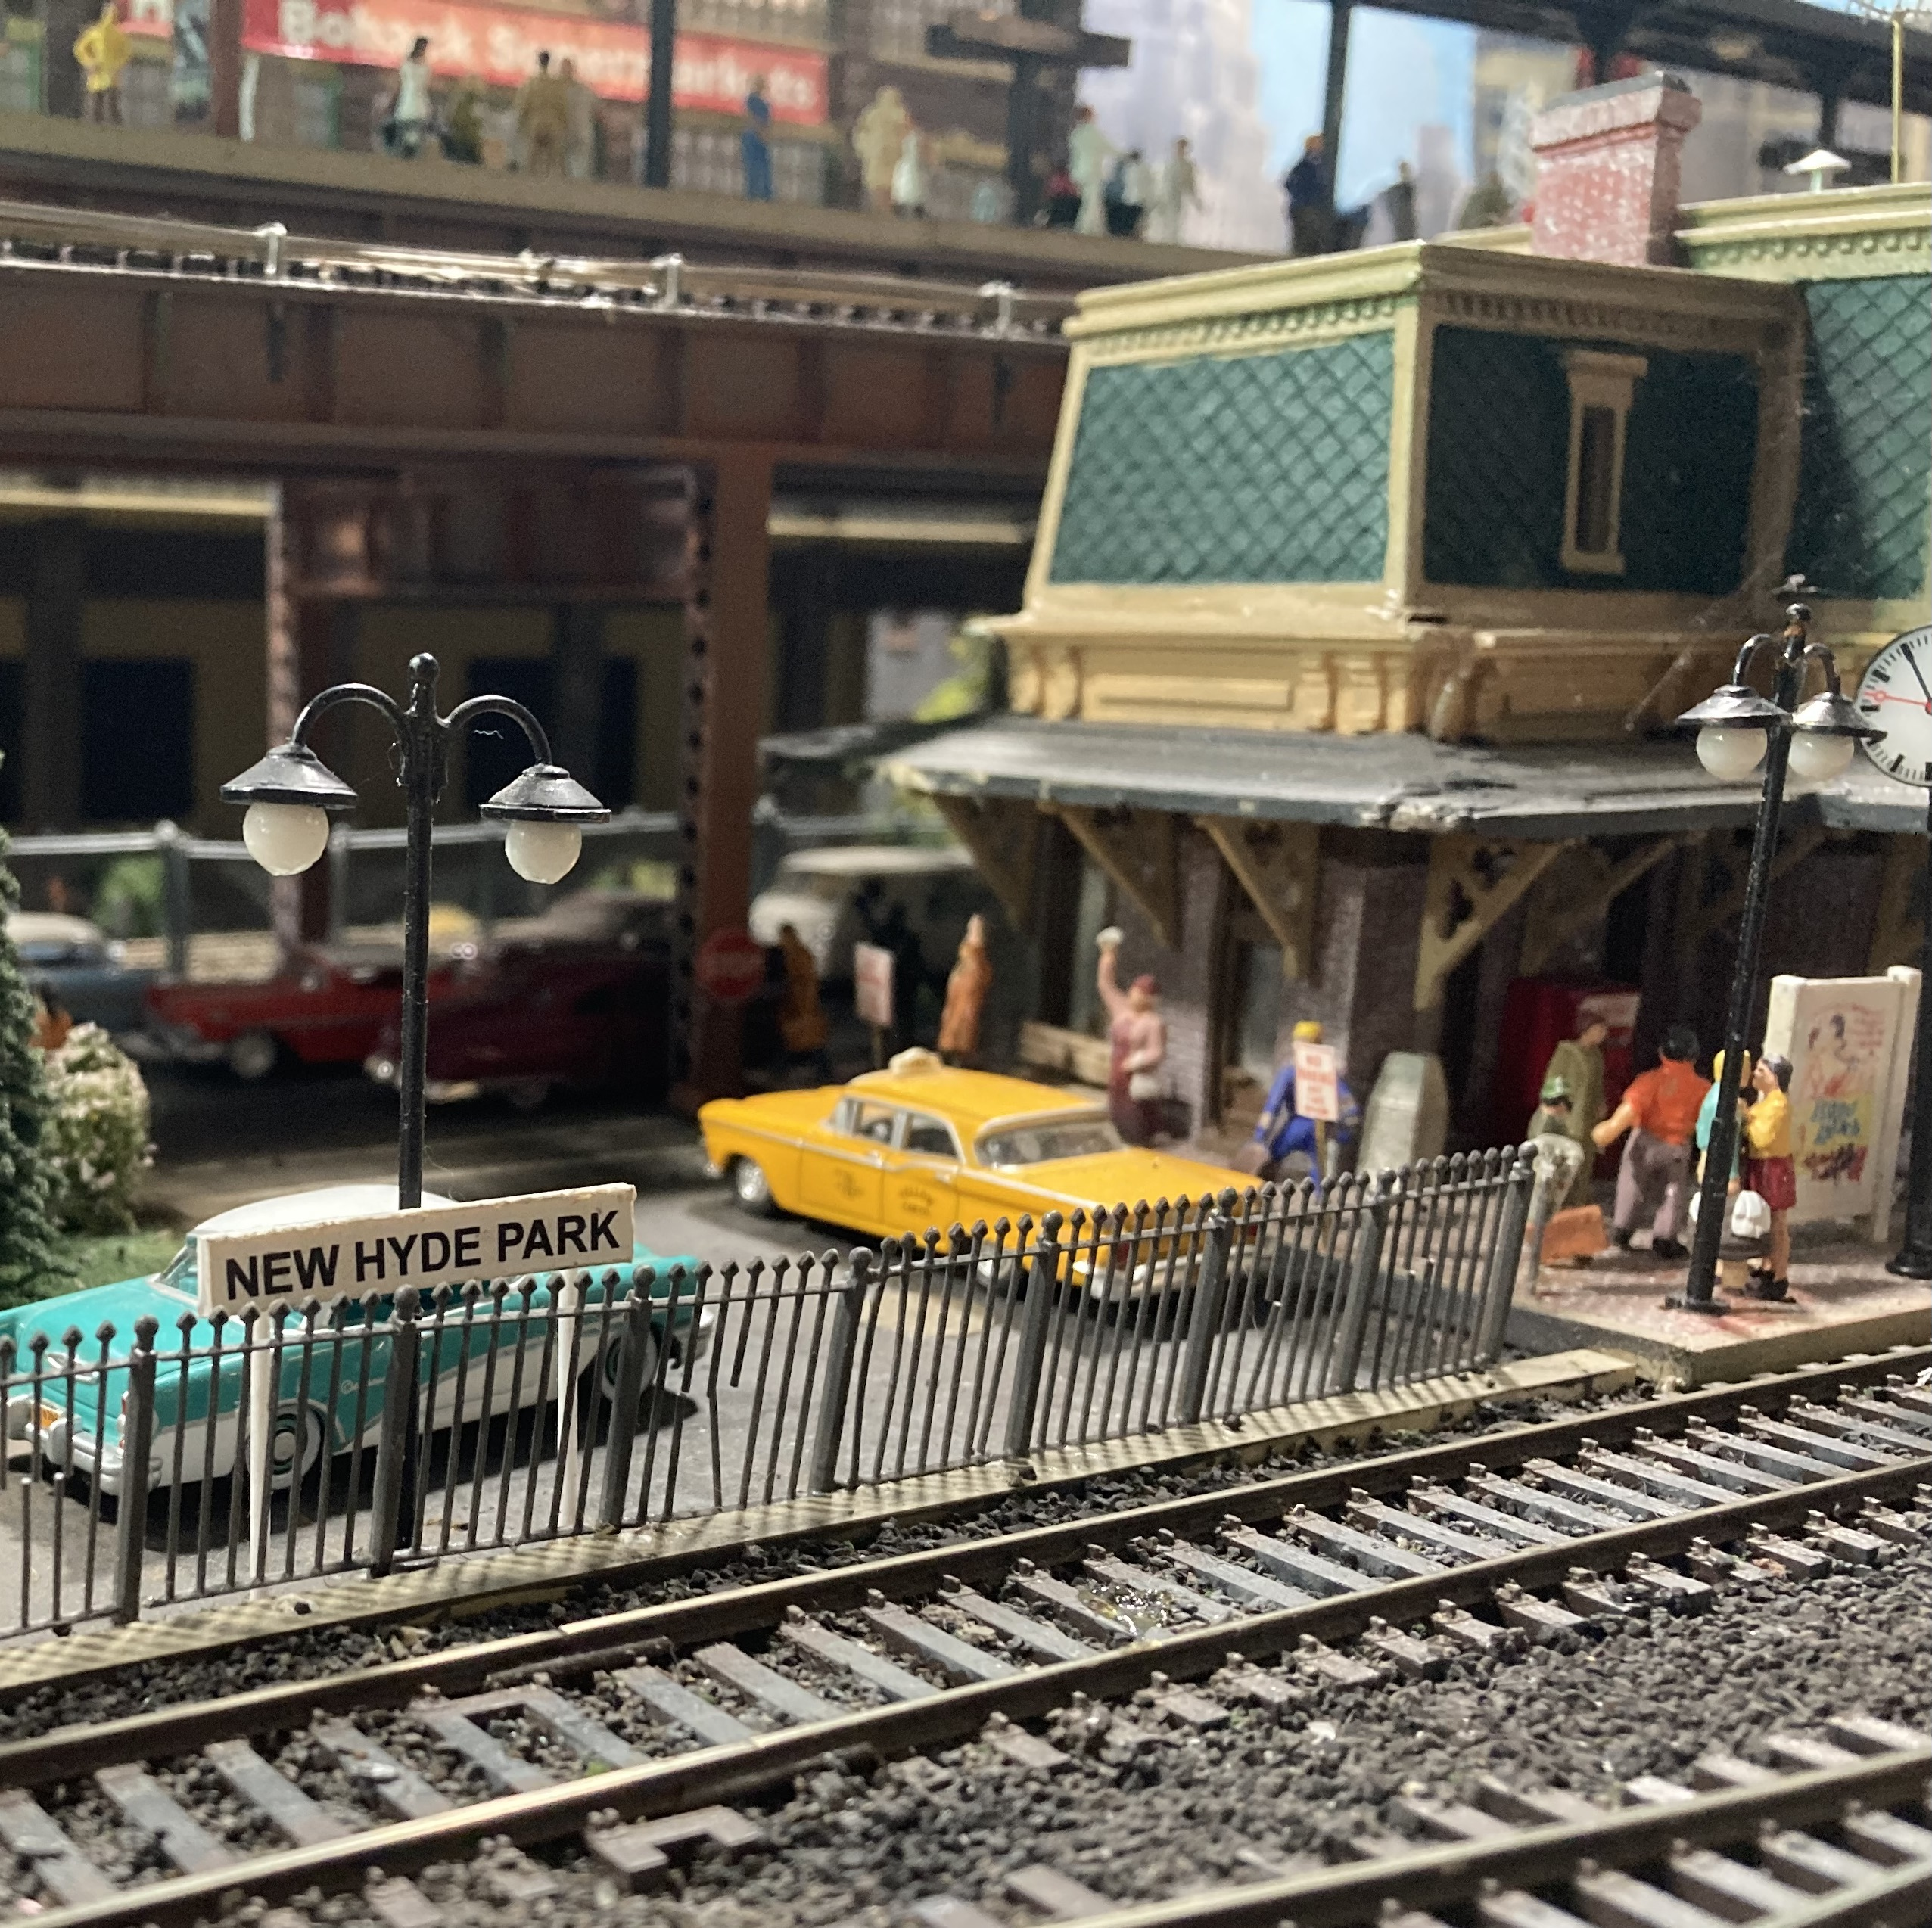
DON’T FORGET ABOUT TRACKSIDE APPROACH SIGNS TO STATIONS

Slide 61
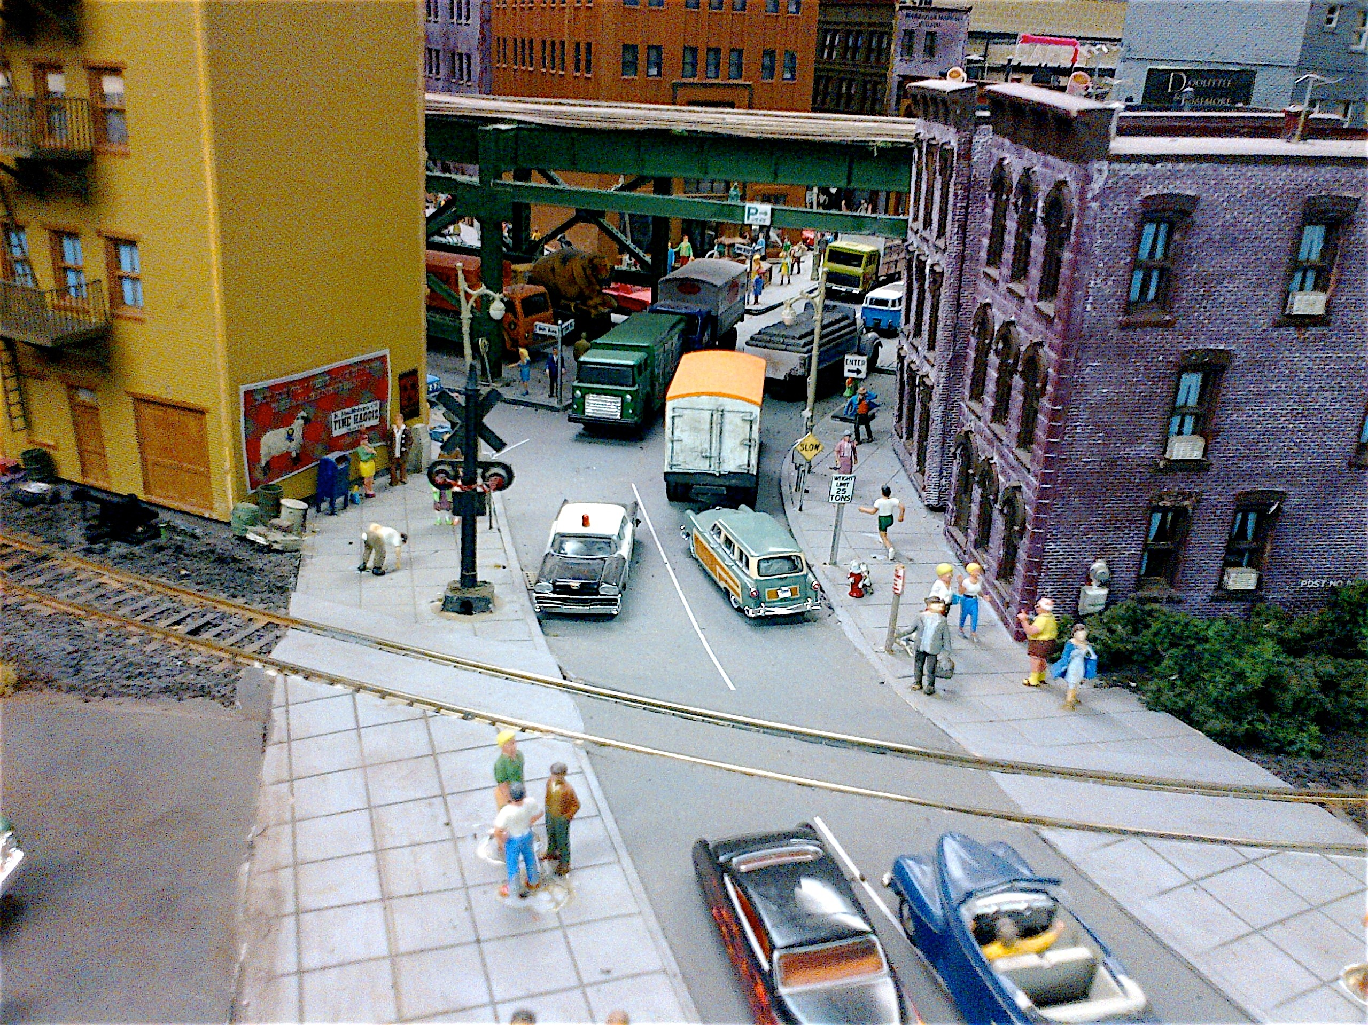
MORE SIGNS ON MY LAYOUT

Slide 62
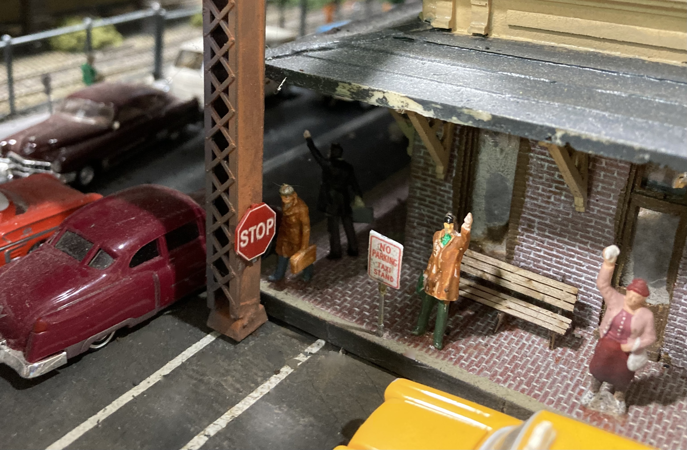
DON’T FORGET ABOUT TAXI CAB SIGNS AT STATIONS

Slide 63
WEATHERING
IN GENERAL, ANYTHING THAT IS OUTSIDE AND NOT NEW OR FRESHLY PAINTED WILL SHOW SIGNS OF WEATHERING
WEATHERING CAN VARY FROM MILD TO SEVERE. WEATHER YOUR STRUCTURES IN A PROTOTYPICAL MANNER
MOST STRUCTURES WILL HAVE VARIATIONS IN WEATHERING FROM ONE ANOTHER, UNLESS THEY WERE ALL BUILT AT THE SAME TIME
EXPLORE VARIOUS TECHNIQUES FOR WEATHERING. AIR BRUSH OVERSPRAYS WITH DILUTED, GRIMY COLORS AND SELF-ADHERING PASTELS ARE TWO EASY, COMMONLY USED METHODS
APPROPRIATE WEATHERING WILL ADD GREAT REALISM
THINGS TO WEATHER
TRACK
ROLLING STOCK
VEHICLES
ENGINES
ROADS, FENCES

Slide 64
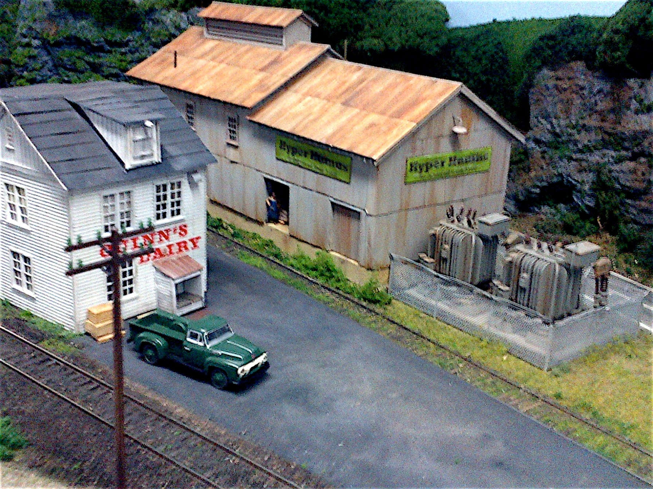
NICELY WEATHERED BUILDINGS
ON BERNIE HALLORAN’S LAYOUT

Slide 65
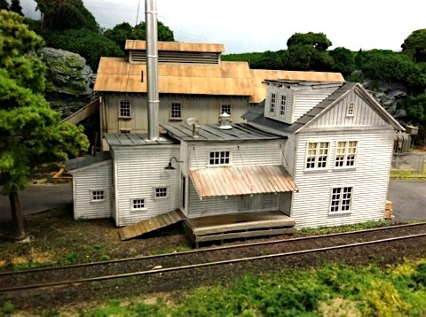
ANOTHER OF BERNIE’S
WEATHERED BUILDINGS

Slide 66
OTHER DETAILS
JUNK
RAILROADS OFTEN RUN BEHIND INDUSTRIAL BUILDINGS OR IN OUT OF THE WAY AREAS. THESE ARE OFTEN AREAS FOR PEOPLE TO LEAVE JUNK
JUNK AND TRASH CAN ALSO ACCUMULATE IN OTHER PLACES. THINK ABOUT WHERE TRASH OR JUNK MIGHT ACCUMULATE AND MODEL IT

Slide 67
ANOTHER EXAMPLE OF TRASH

Slide 68
MORE TRASH

Slide 69
NEWSPAPER BLOWN AGAINST A SIGN

Slide 70
NEWSPAPER BLOWN AGAINST A BUILDING

Slide 71
DON’T FORGET ABOUT GRAFFITI

Slide 72
MORE GRAFFITI

Slide 73
AND DON’T FORGET ABOUT
THE BRIDGES

Slide 74
DETAIL ON ROLLING STOCK

Slide 75
DETAIL ON ROLLING STOCK

Slide 76
BACKGROUND AND PERSPECTIVE
A KEY ELEMENT OF ACHIEVING REALISM IS TO MAKE SURE YOUR SCENES LOOK BELIEVABLE
BACKGROUND SCENERY SHOULD BE SMALLER THAN THE FOREGROUND SCENERY. THIS GIVES THE ILLUSION OF DEPTH AND DISTANCE. IT IS USUALLY CALLED “FORCED PERSPECTIVE”
FORCED PERSPECTIVE CAN BE ACHIEVED IN A NUMBER OF WAYS
USE BACKDROPS THAT SHOW SCENES THAT APPEAR TO BE IN THE DISTANCE
LEAVE A GAP BETWEEN THE SCENERY CLOSEST TO THE WALL AND THE WALL, CREATING THE ILLUSION OF DISTANCE
DEPENDING UPON THE GAUGE IN WHICH YOU MODEL, USE BACKGROUND BUILDINGS, VEHICLES, ETC. THAT ARE A SMALLER SCALE (E.G., USE N-SCALE BUILDINGS AND VEHICLES FOR BACKGROUND SCENES ON HO- SCALE LAYOUTS)

Slide 77
N-SCALE BUILDINGS ON BERNIE HALLORAN’S
LAYOUT GIVE THE ILLUSION OF DISTANCE

Slide 78
N-SCALE BUILDINGS ON MY LAYOUT
GIVE THE ILLUSION OF DEPTH ON A FLAT WALL

Slide 80
I HOPE THESE EXAMPLES GAVE YOU IDEAS FOR HOW TO ADD DETAILS TO YOUR LAYOUT
SOURCES OF DETAIL PARTS ARE AVAILABLE FROM THE WALTHERS CATALOG, LOCAL HOBBY SHOPS, YOUR OWN “MODEL RAILROAD JUNK DRAWER,” ETC.
I PERSONALLY LIKE TO PERUSE E-BAY FOR STUFF. OFTEN YOU CAN FIND INTERESTING STUFF AND STUFF THAT IS NO LONGER MANUFACTURED
MOST OF ALL, BE OBSERVANT AS YOU TRAVEL AROUND. TAKE NOTE OF DETAIL

Slide 81
THIS PRESENTATION CAN BE FOUND ON THE POTOMAC DIVISION WEB SITE
POTOMAC-NMRA.ORG
THANK YOU FOR YOUR ATTENTION
QUESTIONS?

